Slide 1
A Guide for Getting Started with Procore
[[add instructor name and course title]]

Slide 2
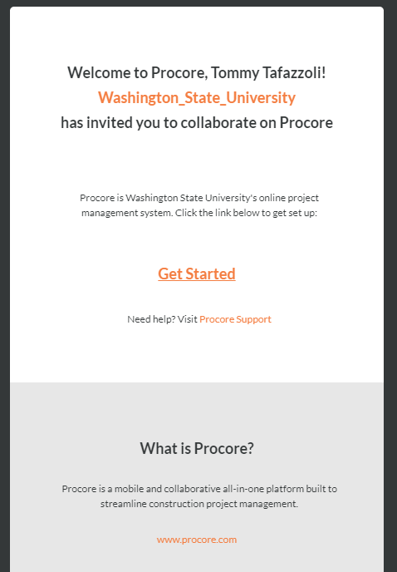
Step 1
Go to the email sent by the instructor, and click on the link to join Procore

Slide 3
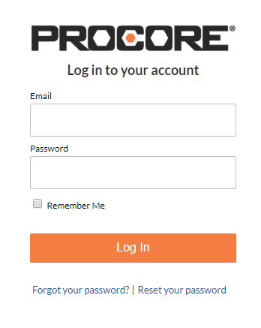
Step 2
Enter your email as the user name and create a password (something you can remember from now on)

Slide 4
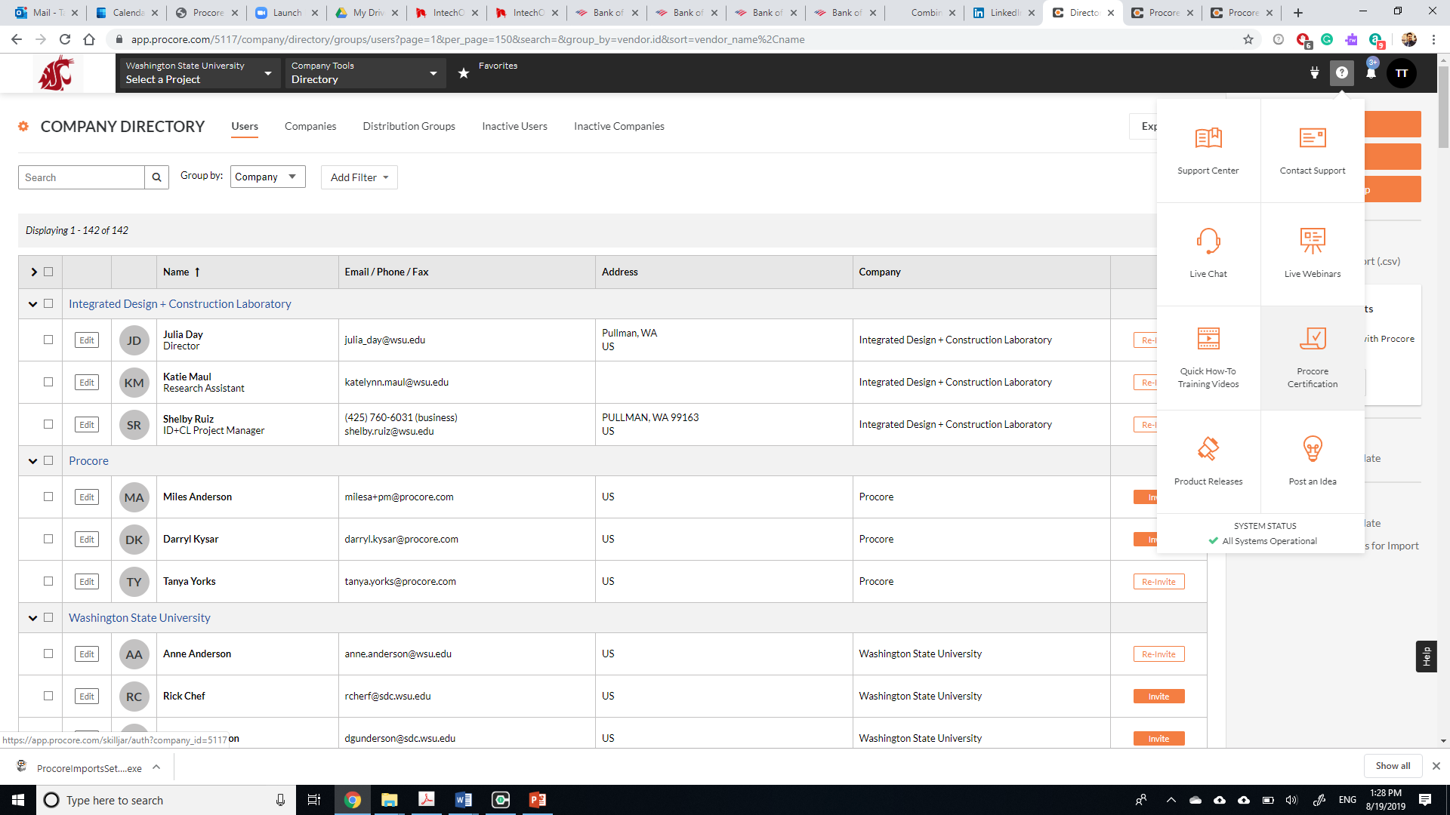
Step 3: Click on the question mark on the top right corner and select Procore certification

Slide 5
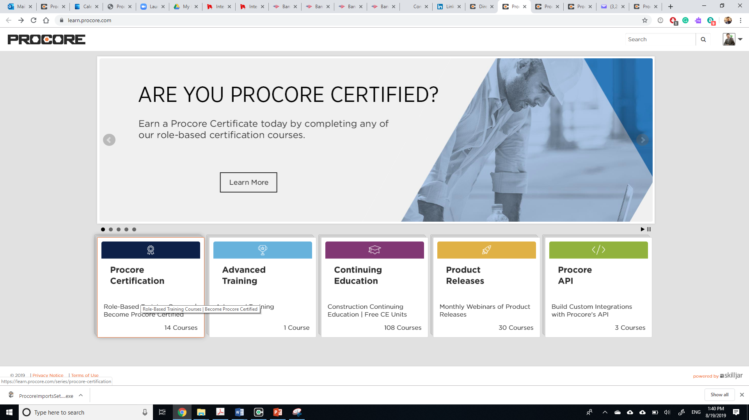
Step 4: Select the fist from the left (Procore certification)

Slide 6
Step 5: Select “I’m a student”

Slide 7
Step 6: Click on the button

Slide 8
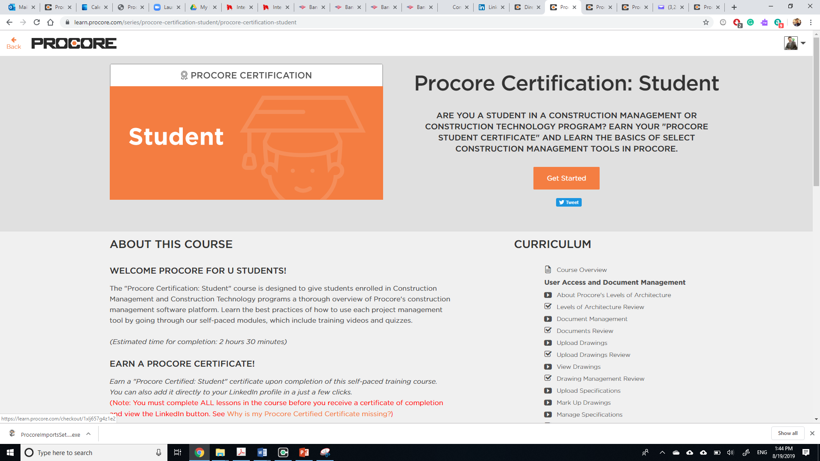
Step 7: click “Get started” to start the course

