Slide 1
Cold Weather Training
October 2023

Slide 2
Overview
Who is carrying cost?
Key Scopes
Earthwork
Footings/slabs
Elevated slabs
Masonry
Interior Finishes
United Rentals

Slide 3
Who Holds Cost
Owner vs. Brinkmann held
Communication!!!
Owner – schedule delay or incur cost?
Weigh the cost versus delay in each scenario
How are you tracking lost days?
How is this carried with subs?

Slide 4
Allowance Log

Slide 5
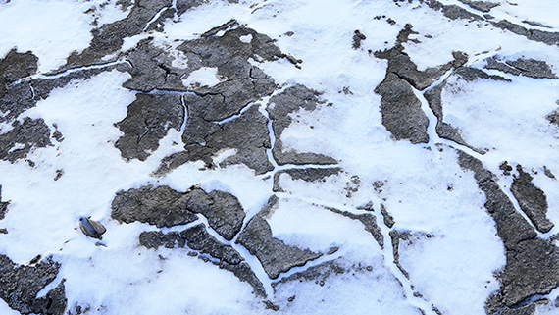
Earthwork & Foundations
Frost in the soil
Remove & replace
Code-L
Additional rock – crane road maintenance

Slide 6
Winter Concrete
Winter Concrete Services
Hot Water
Concrete Additives
NCA (Non-Chloride Accelerator), Fly Ash, High Ranger Water reducers, etc
Historical Unit Costs
Hot Water – $6/CYD
1% NCA - $5/CYD
2% NCA – $10/CYD

Slide 7
Slab on Grade
Frost in soil
Remove & replace – same as soil
Compacted fill
Ground thaw machine
Blankets
Labor & touches
Rental vs Purchase?
~$0.40/SF/MO – Rental

Slide 8
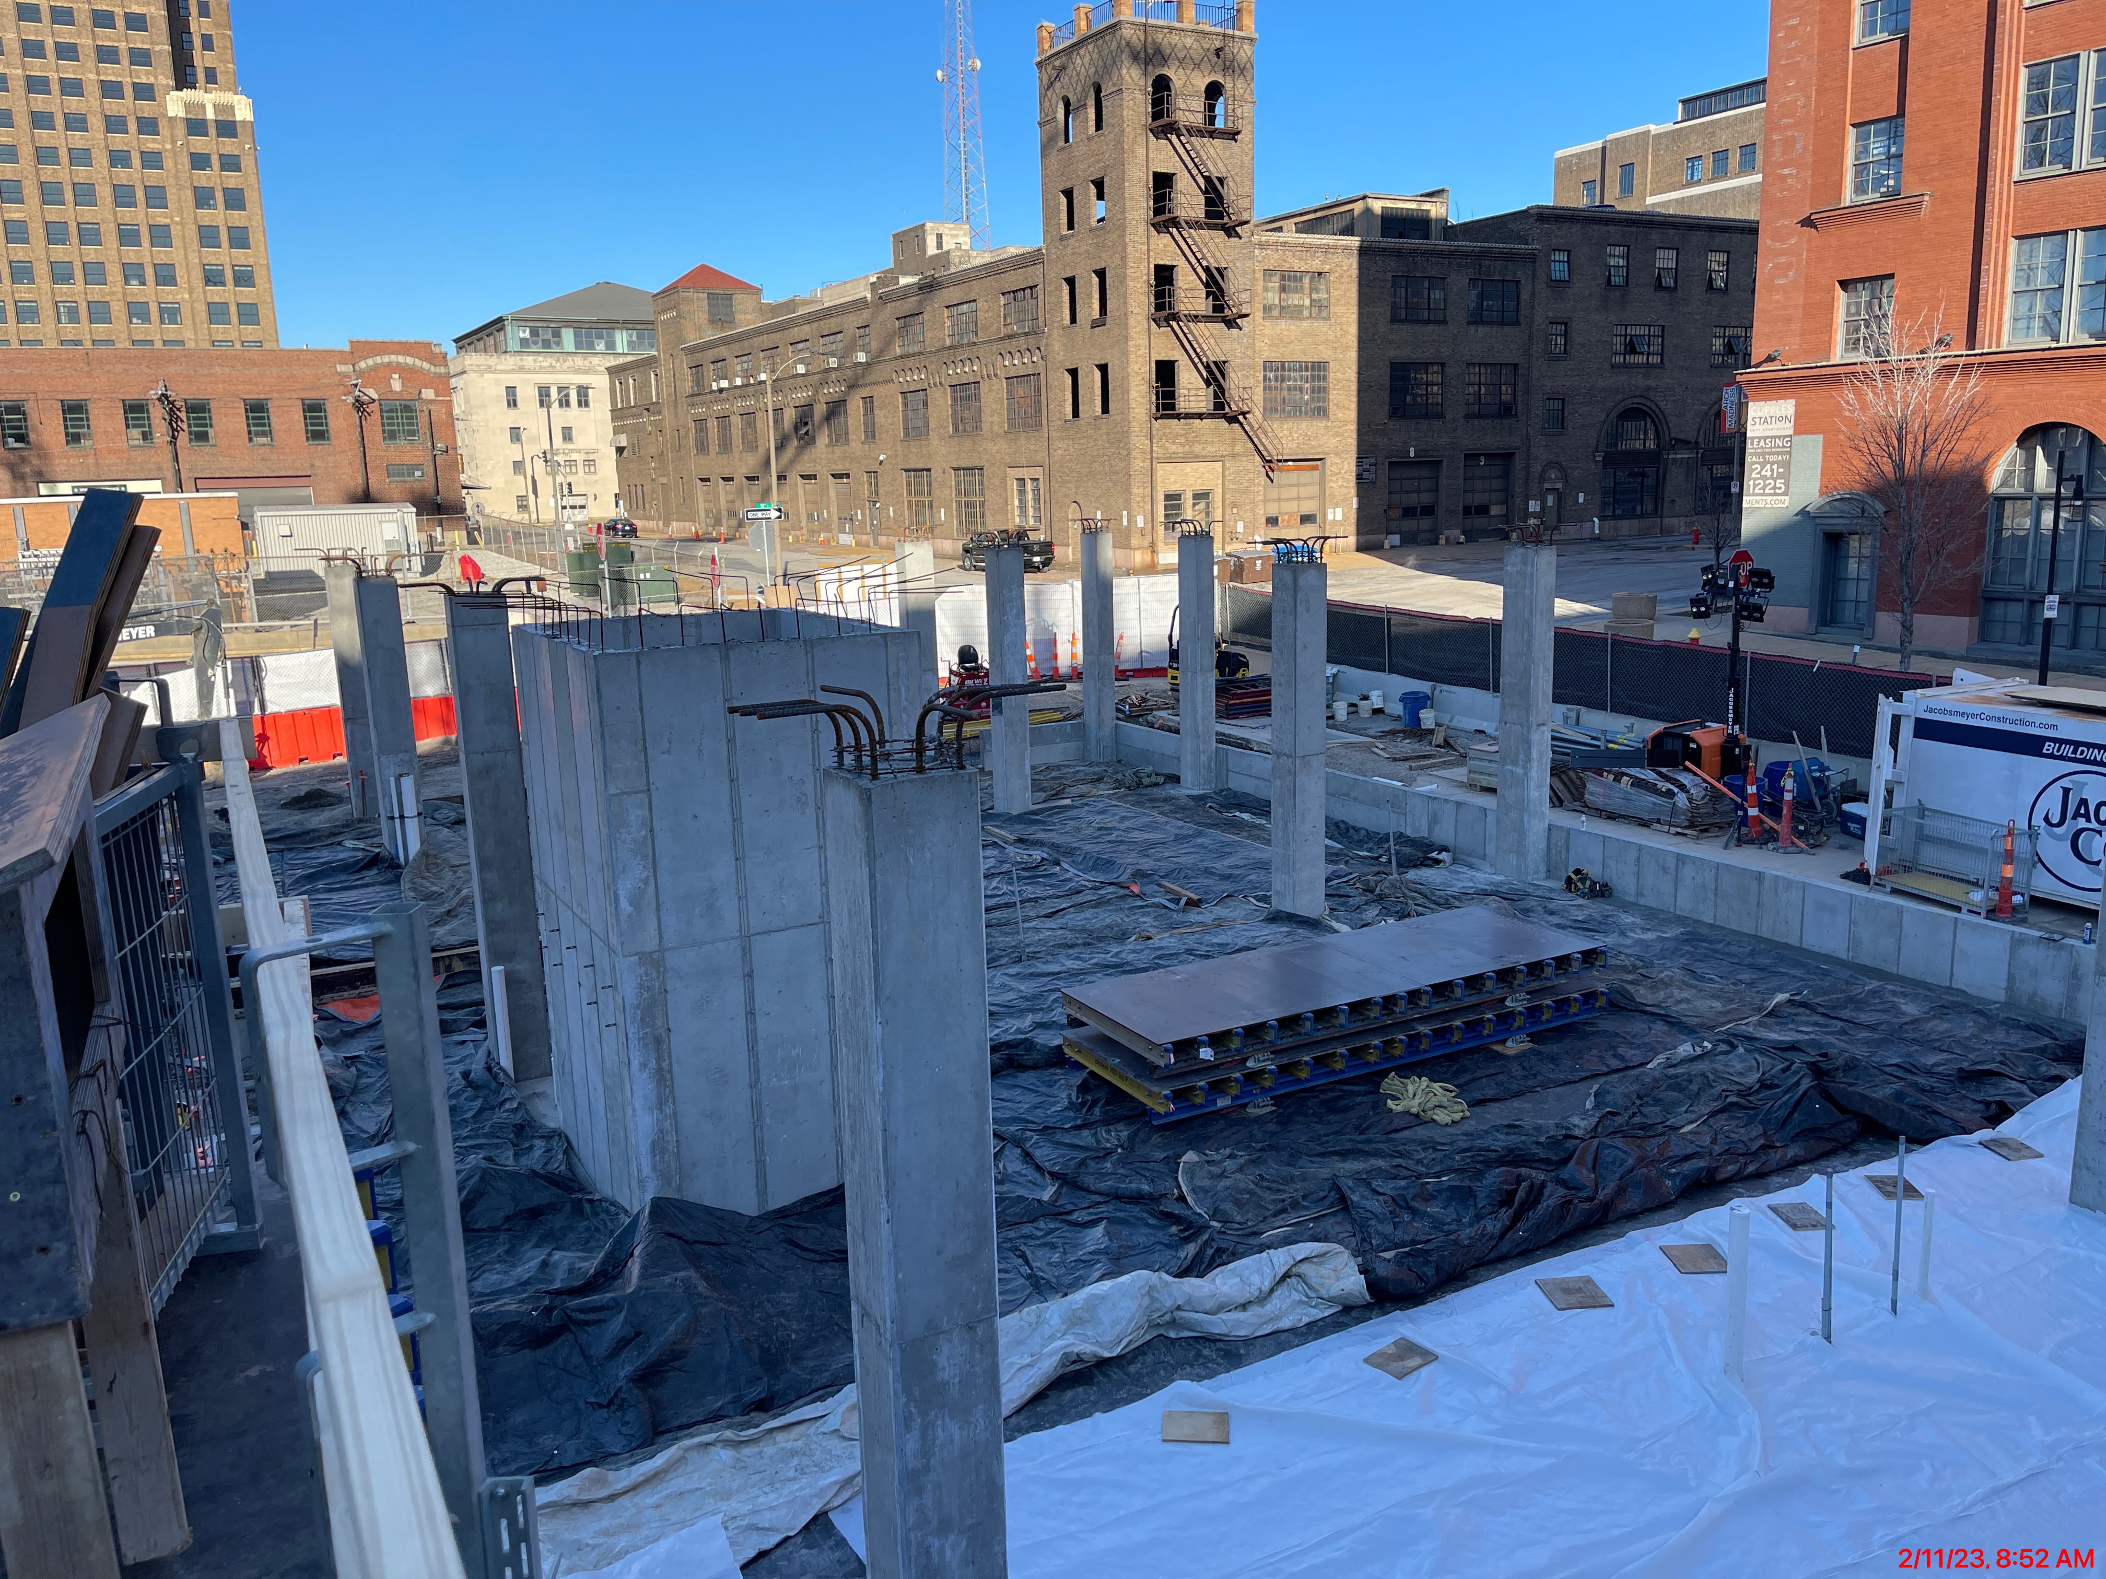
Footings & Slab on Grade Blankets

Slide 9
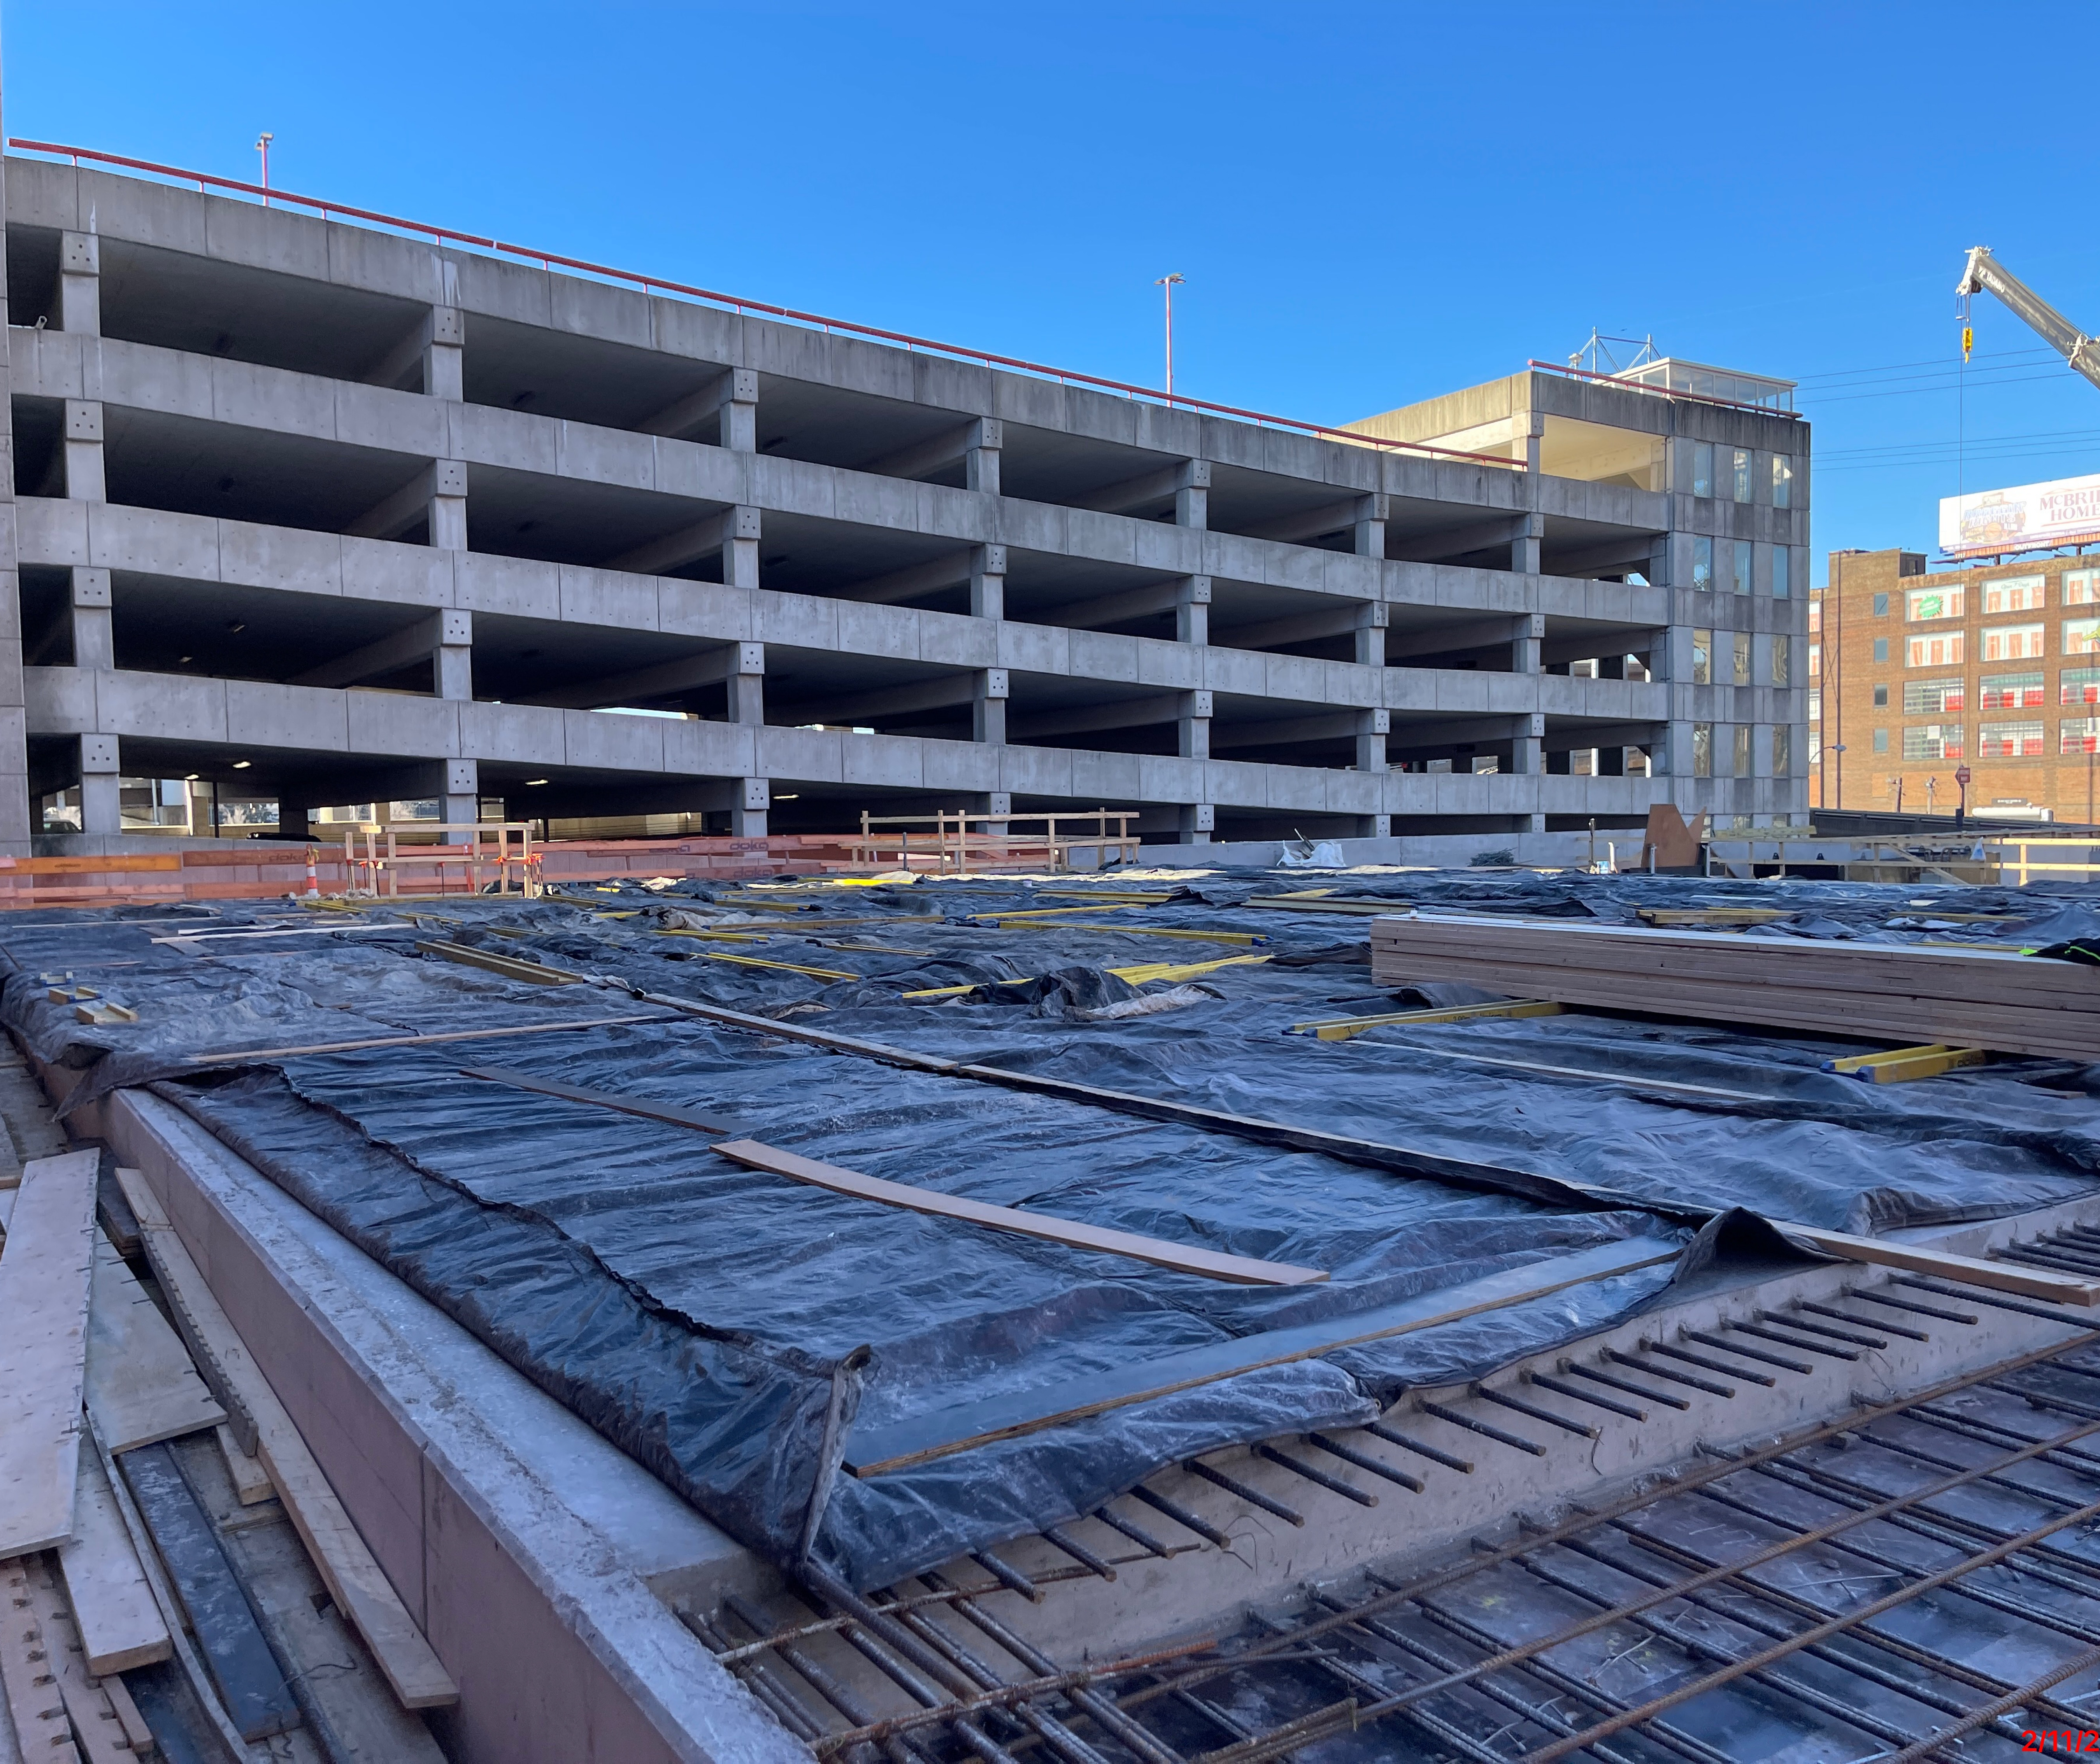
Elevated Slab
Similar to SOG
Hot water
Blankets
Heating under slab

Slide 10
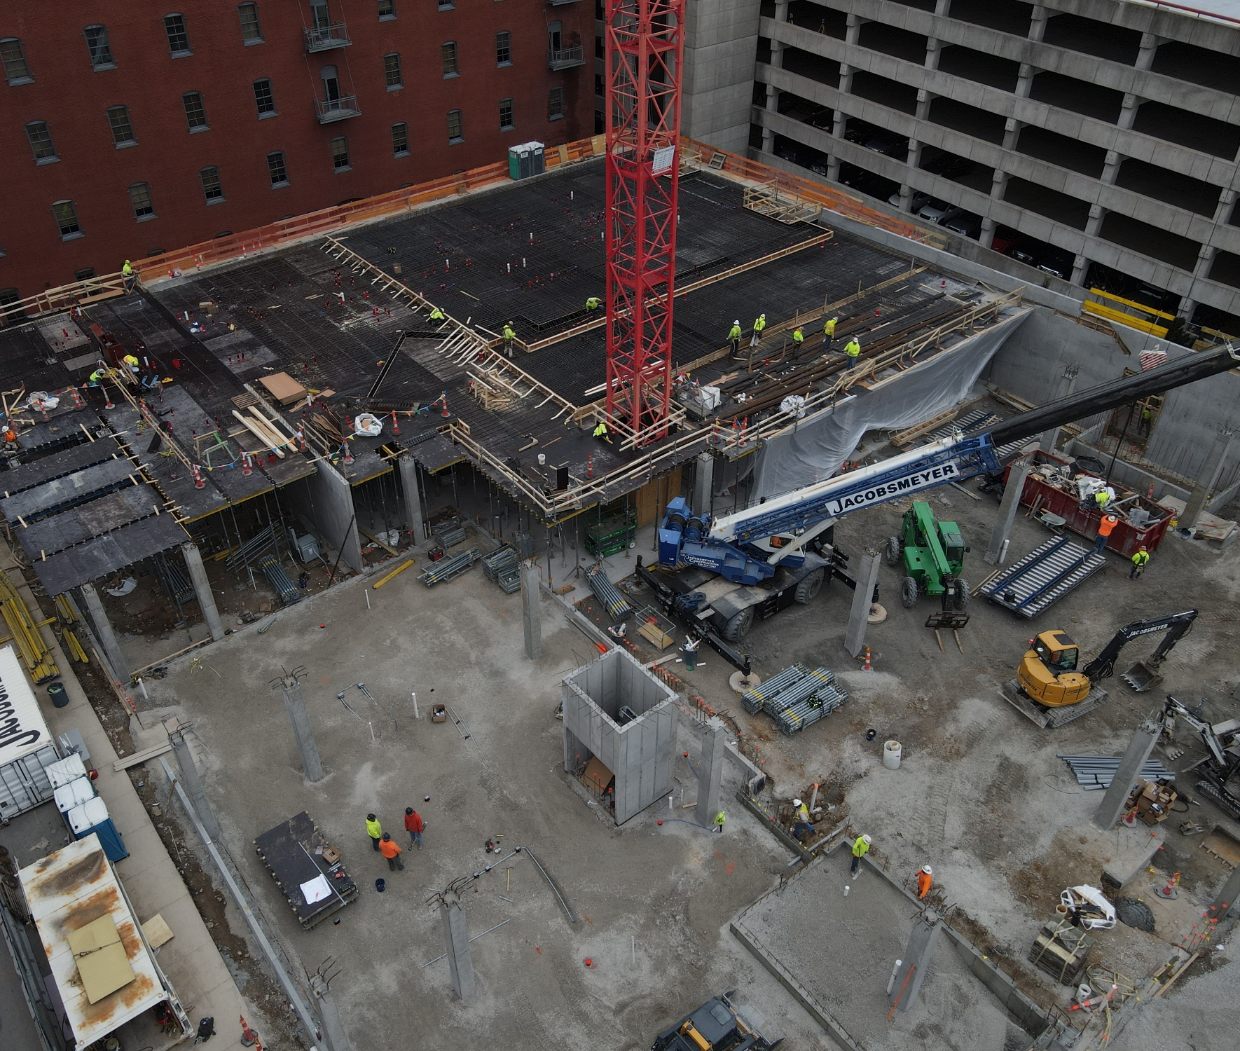
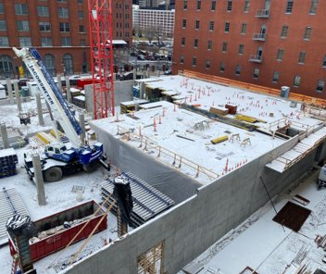
Elevated Slab Tenting

Slide 11
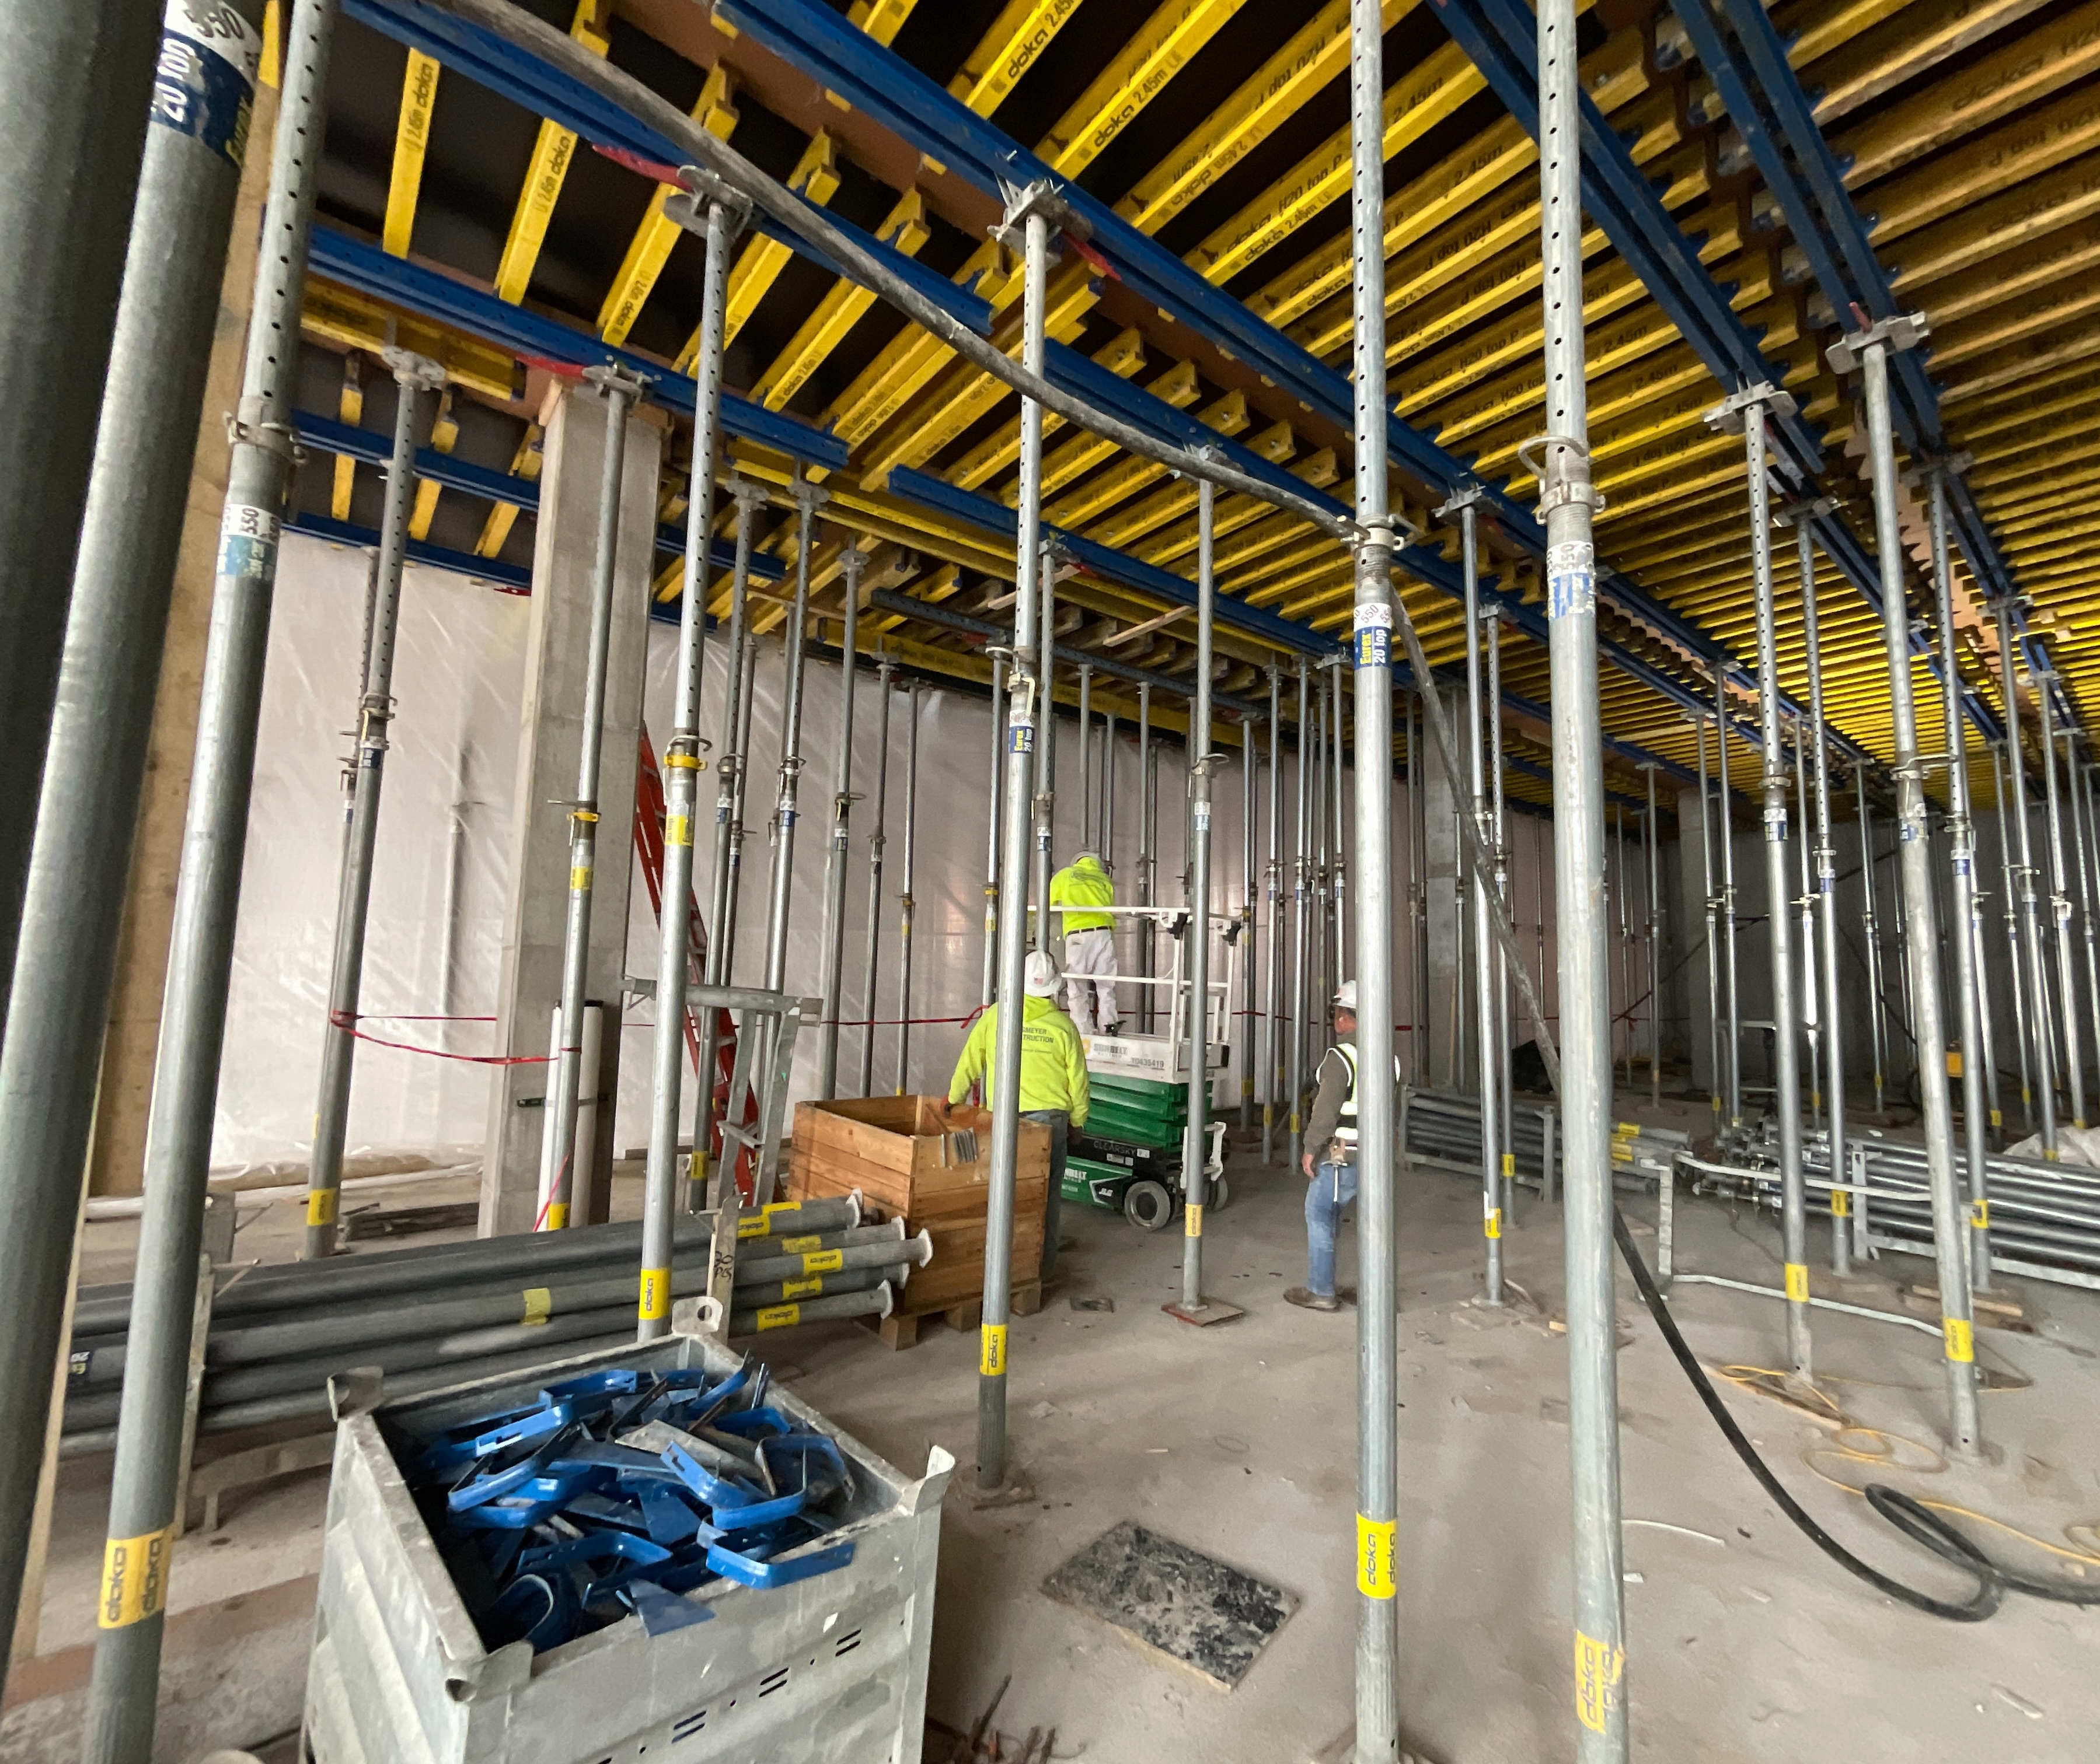
Elevated Slab Tenting

Slide 12
Masonry
Elevator/stair shafts
Grout temperatures
Tenting

Slide 13
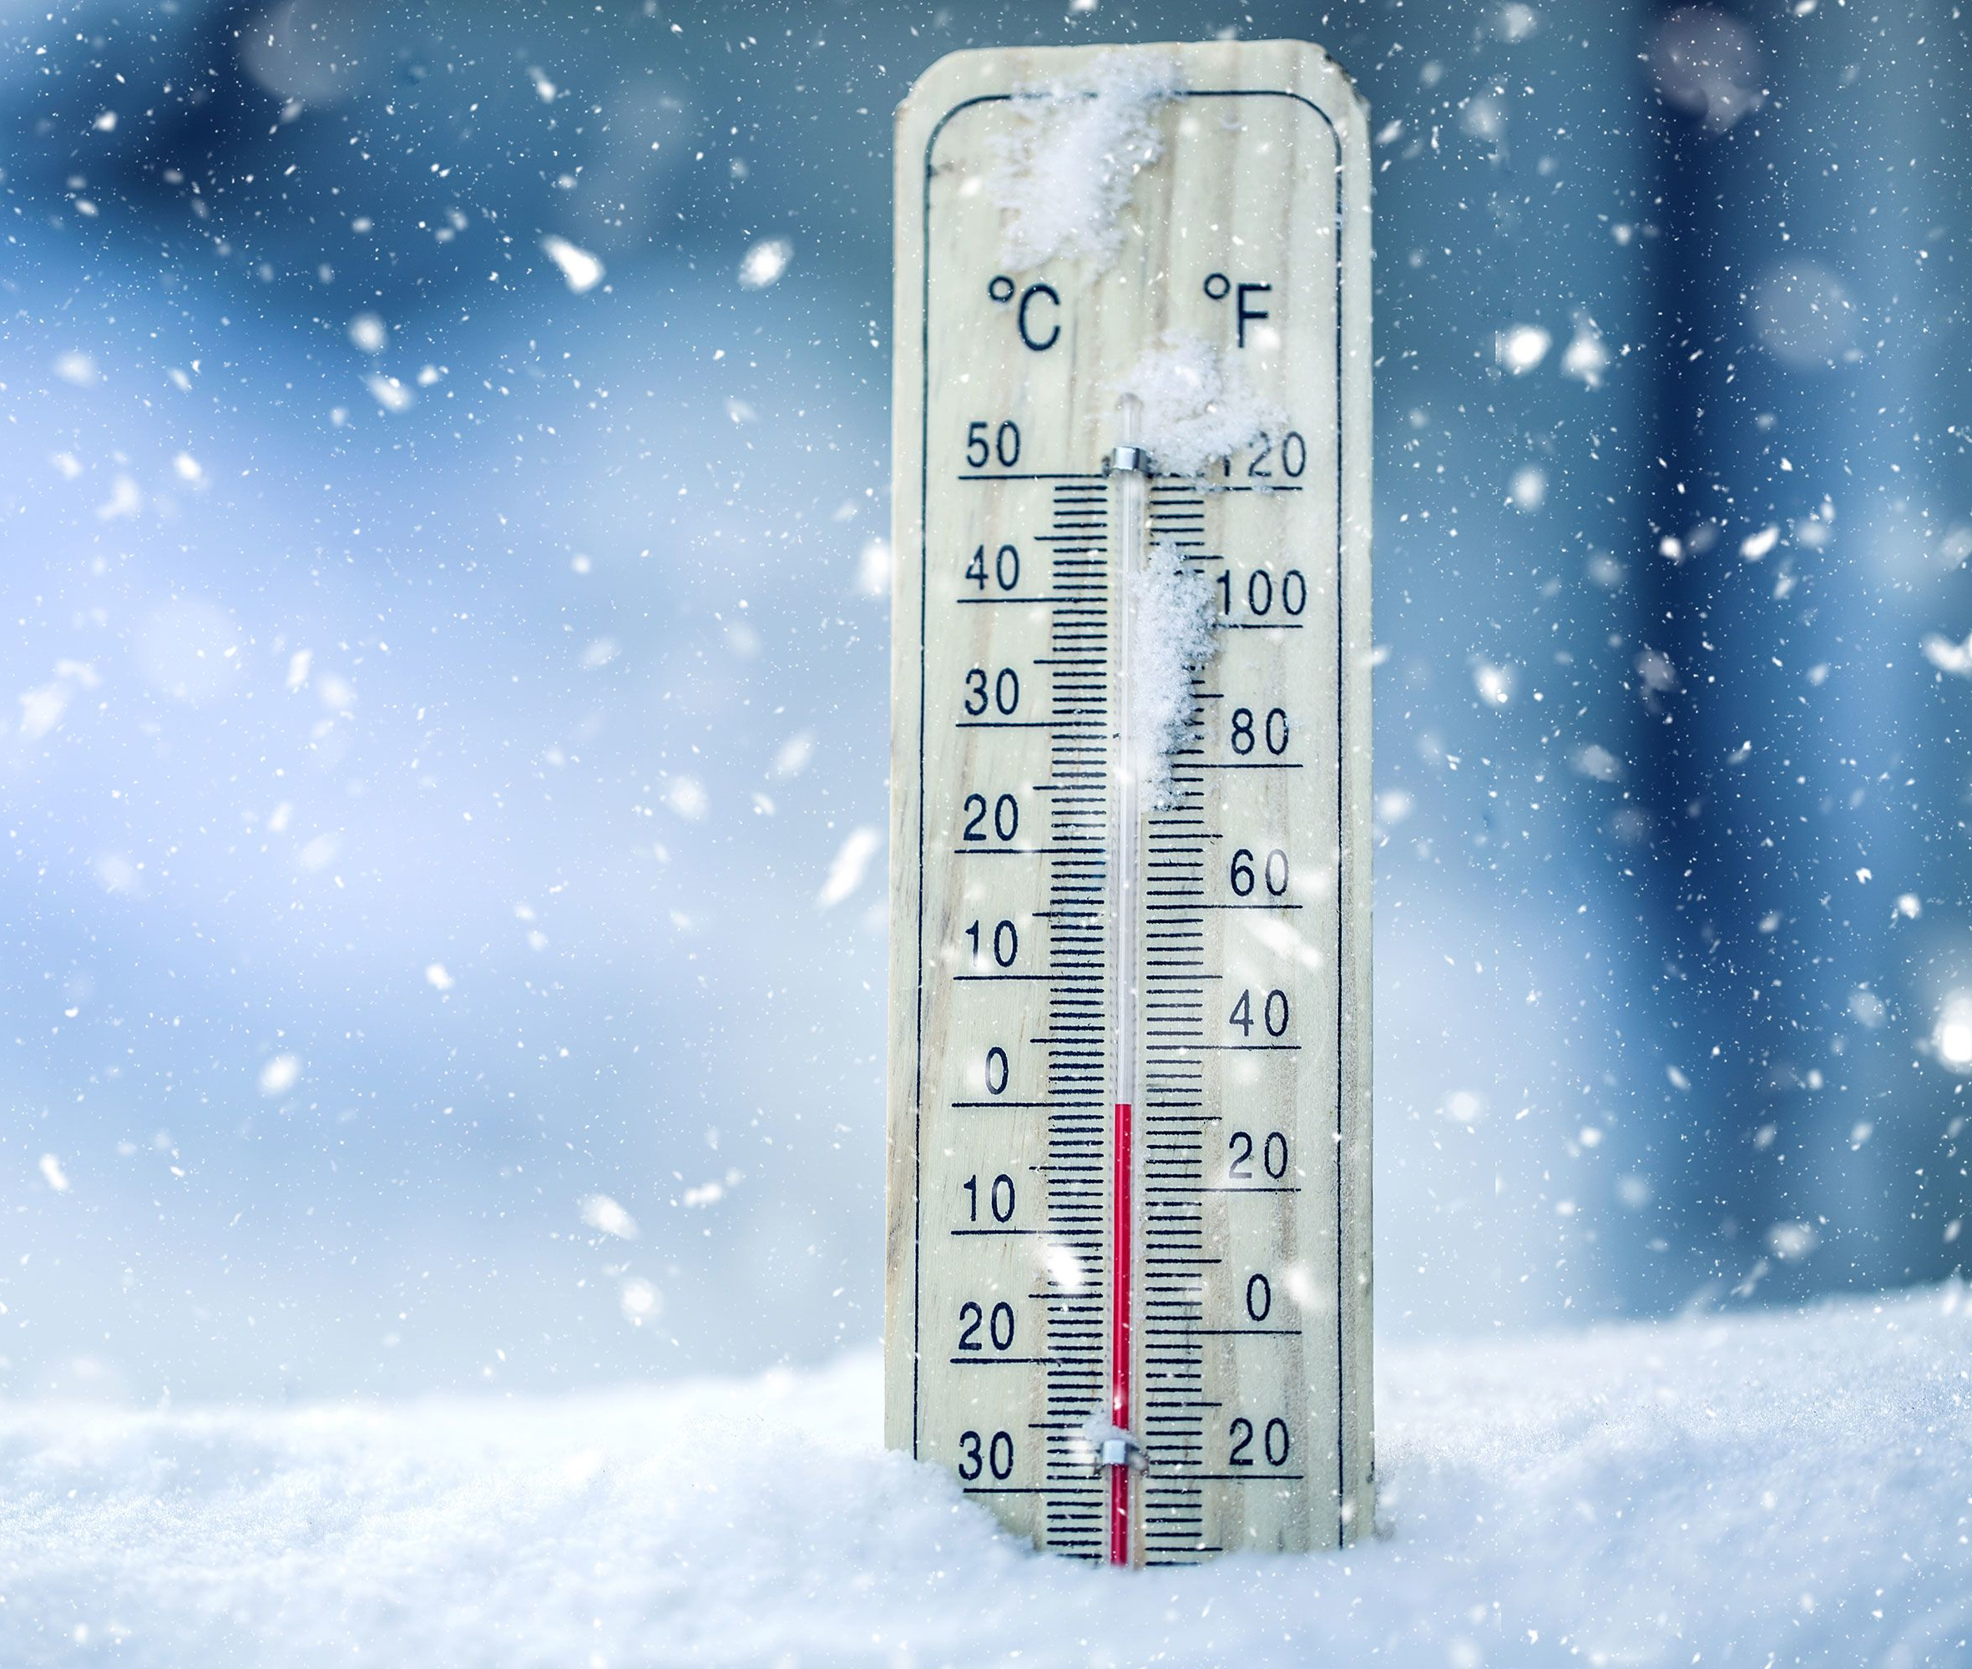
Temp Heating
Permanent systems versus temporary
Beating winter
Retail in multifamily

Slide 14
Temp Heating – Permanent
Extend your warranty period on HVAC
Additional filter changes
Buyout – winter or summer
Permanent power
Exterior facade or temp enclosure
windows

Slide 15
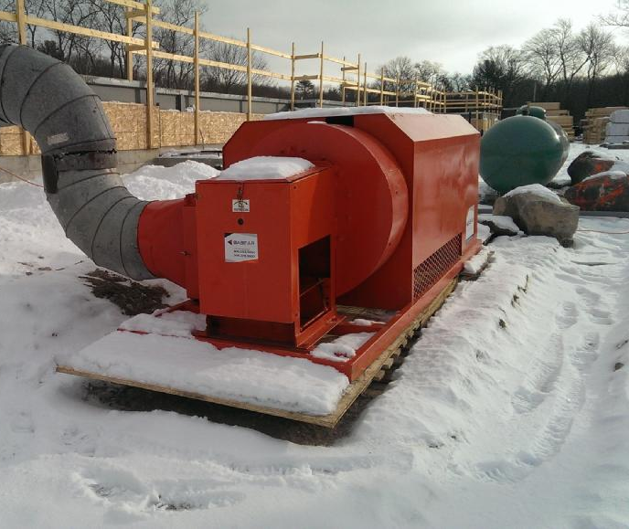
Temp Heating – Temporary Systems
Power supply
Gas supply
Permanent meter
Types of heaters
Building types will determine
Insurance requirements
Ducting heaters
Labor for moving heaters & filling

Slide 17
Basic Heating Principles
Understanding The Fundamental's

Slide 18
Glossary of Terms
CFM - Cubic feet per minute
CFH – Cubic feet per hour
BTU (British Thermal Unit)
Infiltration Heat Loss
Air Change Rate
Ventilation Rate
Design Temperature Difference
“U” Value

Slide 19
Direct Fired Heater
Verses
Indirect Fired Heater
Choosing the right heater for the application

Slide 20
Direct Fired Heater
Must use 100% outside air for combustion air, (never recirculate)
Natural gas or propane gas only
Best heater for heating large spaces
Will provide higher CFM of low R.H. air
Most units can support over 400’ft of fabric duct
10 to 1 fan induction ratio (Centrifugal Blower)
100% Fuel efficiency
180ºF high fire & 100ºF low fire

Slide 21
Indirect Fired Heater
Fuel oil & natural gas or propane fired
The air can be recirculated
Lower CFM better suited to small area’s
Self contained fuel oil units
Towable up to 1 Million Btu’s/hr
Currently limited to 2 million btu’s/hr output
Most are limited to 100’ft of discharge duct
80% Fuel efficiency

Slide 22
Byproducts From Combustion
Only 92% of natural gas and propane can be converted to energy the remaining 8% become:
Water Vapor
Carbon Dioxide
Carbon Monoxide
Every Million btu’s of fuel burned will produce:
11.7 gallons of water from natural gas
9.7 gallons of water from propane

Slide 23
Understanding How Air Behaves
Air only knows one thing to equalize itself with the ambient air
The hotter the air the faster it rises upward
The warmer the air the more water it can hold
For every action there is a opposite and equal reaction
Recirculation of the inside air increases infiltration of outside air

Slide 24
Air Change Rate Requirements
Using outside air for combustion air creates positive pressure on the buildings envelope forcing air through the cracked and crevices
We can calculate the air change rate by dividing the building volume by the equipment CFH
Rules of Thumb
1 air change every 2 hours is the minimum
1 air change every hour up to 1.5 air changes is needed on taller structures

Slide 25
Current List of Makeup Air Heaters

