Slide 1
ESTIMATING and TAKEOFF

Slide 2
Learning Objectives
Understand the difference in quantity takeoff and estimating
Understand the quantity takeoff process
Identify components used in performing a takeoff
Assign pricing to derived takeoff quantities
Develop an estimate using derived pricing and project commitments
Notes:
This PPT presentation helps define the difference between a takeoff and an estimate, and prepares students for the Procore Estimating and Takeoff Module.

Slide 3
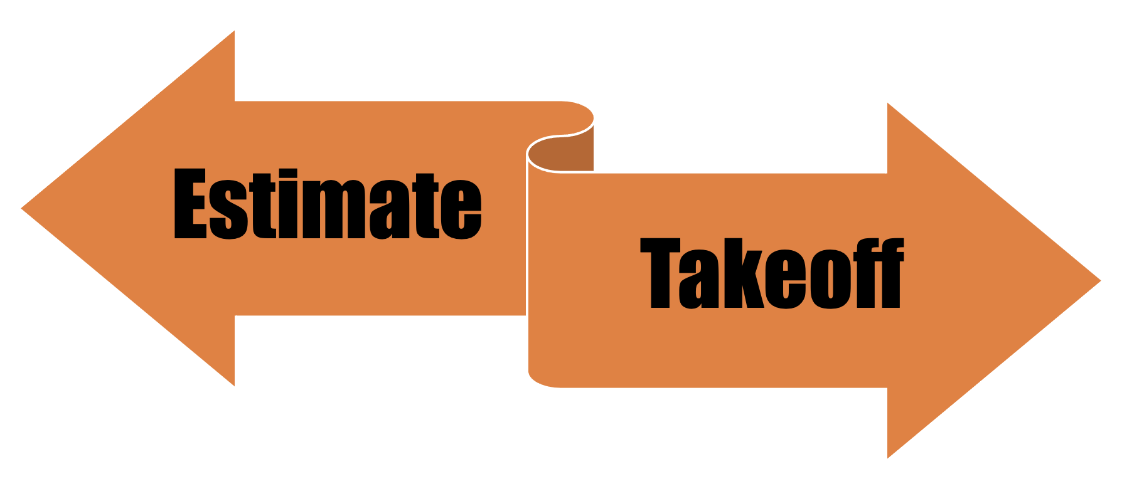
Quantity Takeoff vs. Estimate
A takeoff is determining quantities of Materials and Labor
Estimating is applying costs to the work needed to complete the project

Slide 4
Quantity Takeoff
An assessment of the quantities of materials and labor to be used in the construction of a project

Slide 5
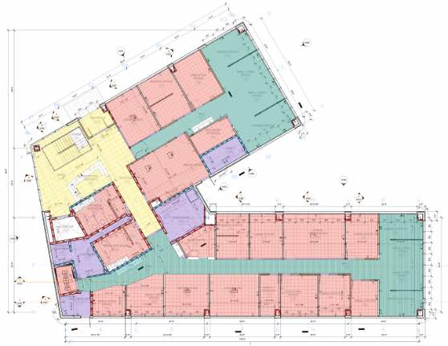
Manual Quantity Takeoff
A manual quantity takeoff can include the simple counting of items, or the use of various calculations and formulas to determine the quantity

Slide 6
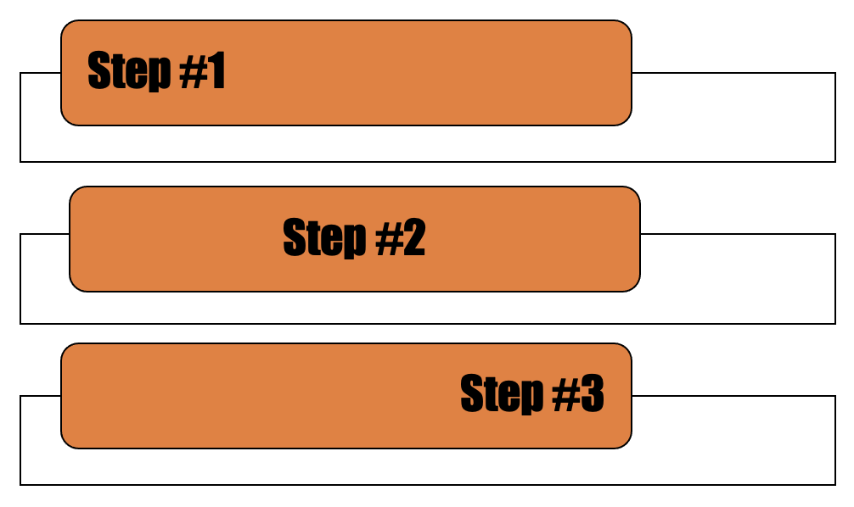
The Quantity Takeoff Process
Breaking down a project into manageable units
Determining what quantities are needed
Assessing the material type and quantity detailed on the construction drawings

Slide 7
Takeoff Components
Each (EA)
Lump Sum (LS)
Linear Foot (LF)
Square Foot (SF)
Cubic Foot (CF)
Cubic Yard (CY)
Board Feet (BF)
Other
Notes:
These are the most commonly used components but other are used.

Slide 8
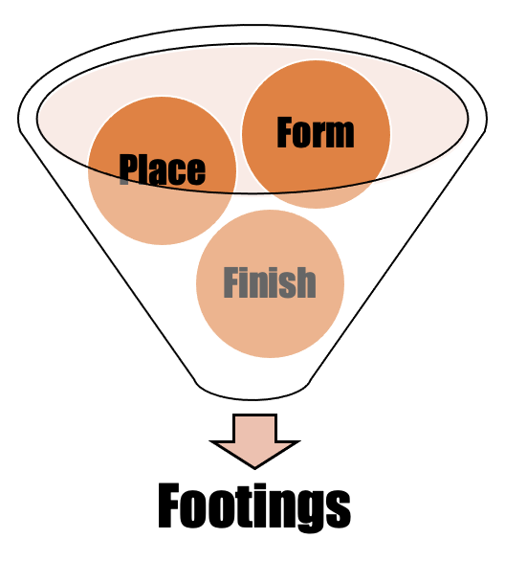
Work Packages
Material quantities and labor can be combined to create work packages
Individual components taken off in their own units (EA, SF, SY, CF, and CY) and then combined into a work package to tracking of larger scopes

Slide 9
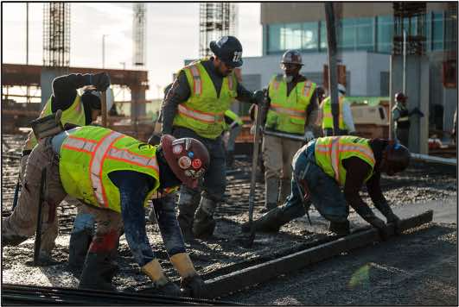
Labor Production Rates
Known Production Rates are assigned to components of work (and associated quantity) to determine the quantity of hours required to complete a quantity of work

Slide 10
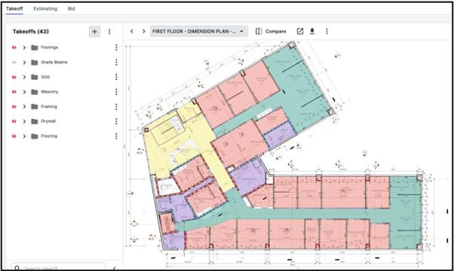
Using the Procore Takeoff Tool
The Procore Takeoff tool allows for an on-screen (digital) take-off, facilitating, automating, and enhancing accuracy of a takeoff.

Slide 11
Takeoff Exercises
Takeoff Exercises
Doors – (Count)
Flooring – (SF and LF)
Steel Studs – (LF and SF)
Footings – (CY & SF)

Slide 12
Estimating
The process of using the quantities taken off to assess all the costs of a project, including direct costs, indirect costs, overhead costs, and profit.

Slide 13
Estimating
Assigning Costs
Labor Costs
Material/Item Cost
Equipment Cost
Other (Subcontractors and Suppliers)

Slide 14
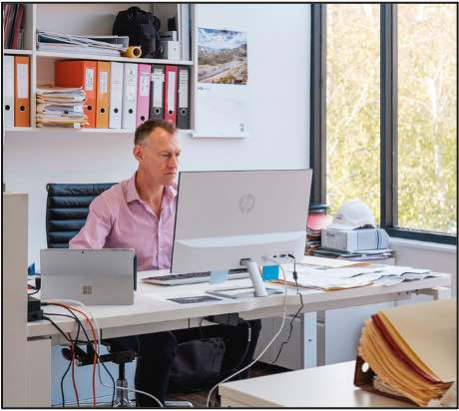
Assigning Costs to Quantities
Costs can be assigned by:
Item/Unit Cost
Work Package Costs

Slide 15
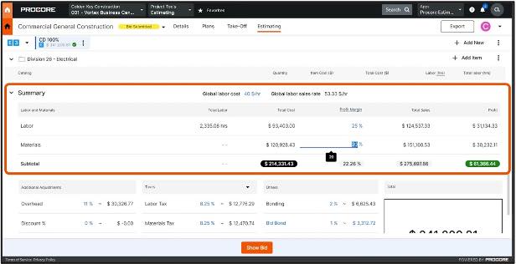
Using the Procore Estimating Tool
The Procore Estimating tool facilitates, automates, and enhances the accuracy of an estimate.

Slide 16
Estimating Exercises
Assigning Costs
Item Cost
Labor Costs
Total Costs
Total Labor Hours

Slide 17
Questions?

Slide 18
Thank You for Using
PROCORE

