Slide 1
Procore for Universities
Notes:
This presentation is intended to help professors introduce Procore to their students.

Slide 2
What is Procore?
Why am I learning it?
How to Advertise Your New Skills
Companies that Rely on Procore

Slide 3
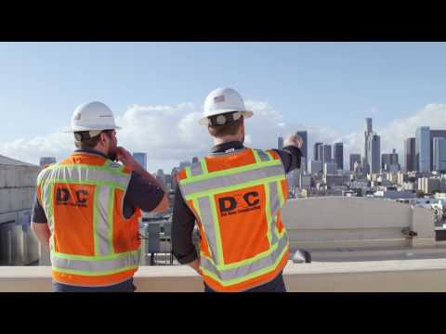
Procore in Industry
Notes:
This video gives a 5 minute overview of how Procore can be used to streamline processes in the construction industry.

Slide 4
Notes:
Discuss why students should invest the time to learn Procore.

Slide 5
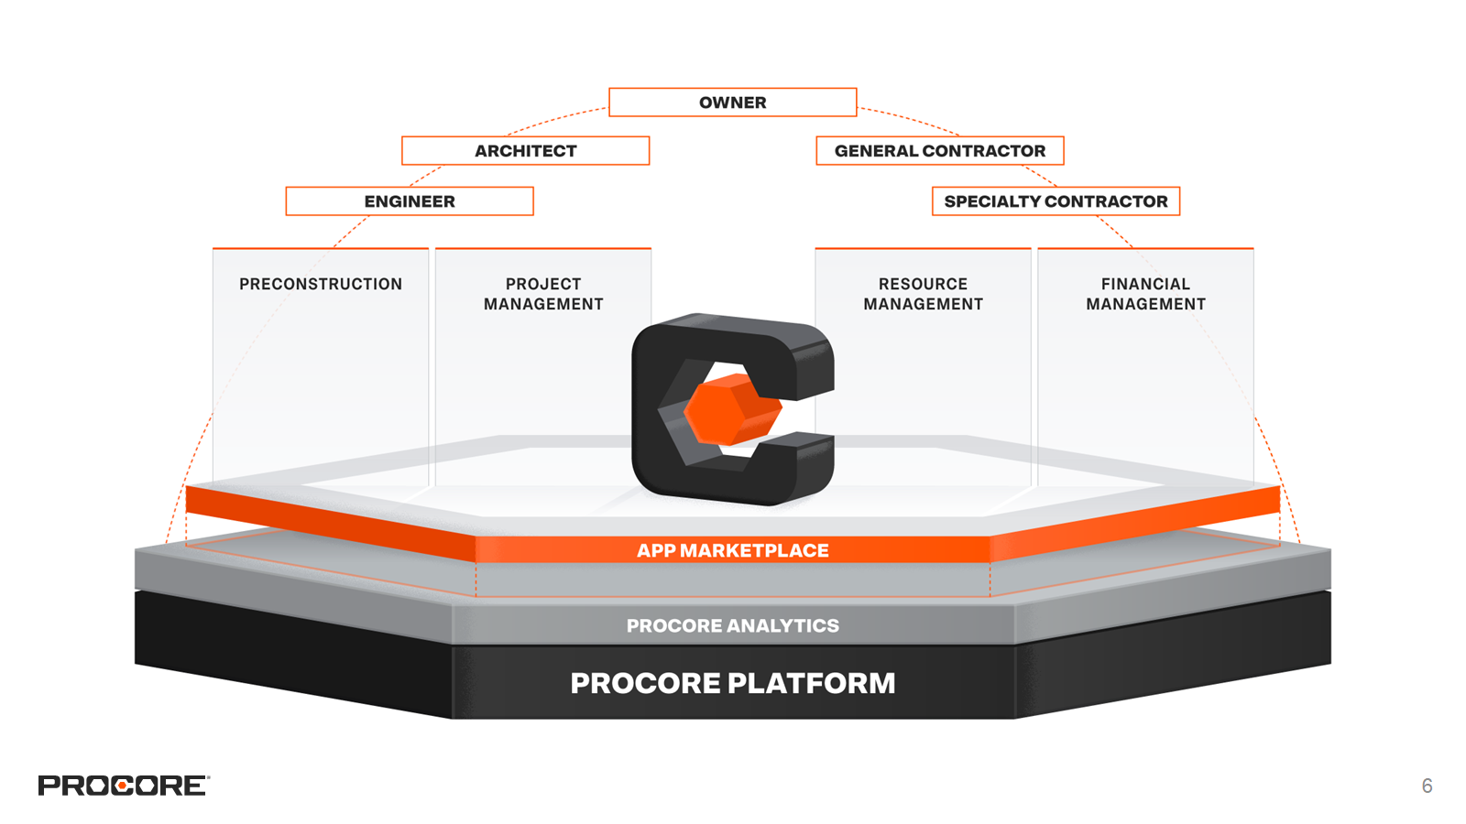
Notes:
The Procore platform allows construction teams to manage each phase of construction project. The unlimited user licence and collaborative nature of the tools allow for everyone on the project to get involved, leading to streamlined processes and a central source of truth and documentation.

Slide 6
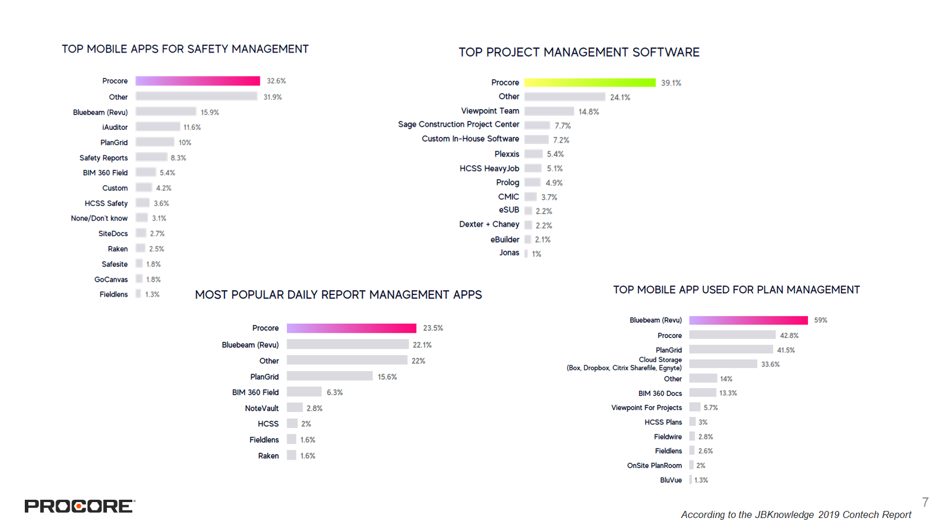
Notes:
These statistics from the 2019 Contech Report demonstrate the likelihood of encountering Procore on a jobsite today. It’s important for students to have access and exposure to technology that is being used in their field. If, out of college, they are already prepared with the skills they’ll need to succeed, they are seen as a more attractive candidate for employment.

Slide 7
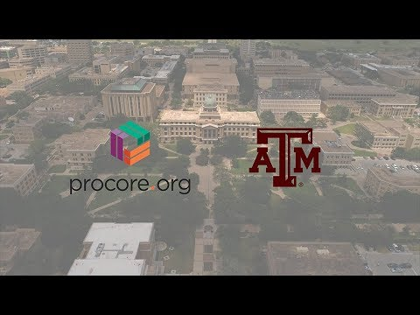
Texas A&M + Procore
Notes:
This video will share more about how Procore is being used in the CM program at Texas A&M.

Slide 8
"Procore gives DU students real world experience in the latest construction management technologies. They are more prepared for a career in the construction industry.” Eric Holt, Assistant Professor of University
of Denver
Notes:
The more prepared students are when they graduate, the more likely they are to land their dream job.

Slide 9
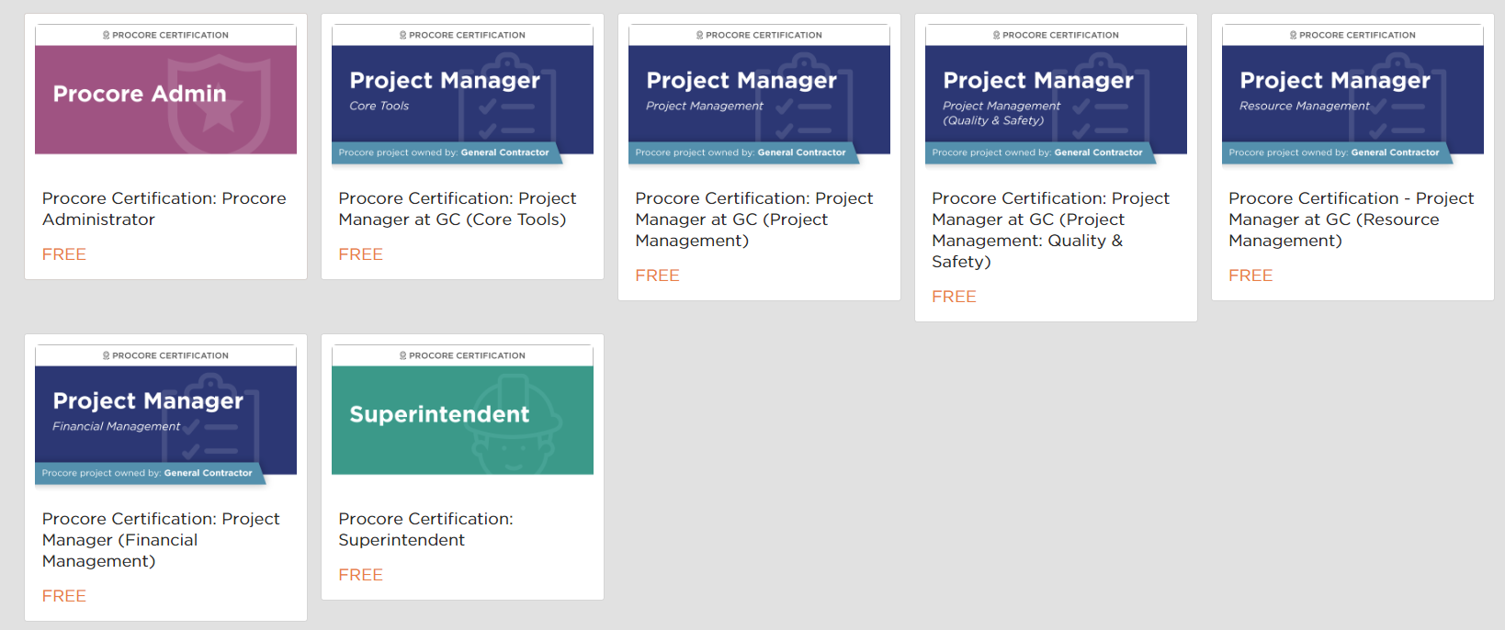
Become Procore Certified!
Showcase your Procore credentials on LinkedIn
Connect with potential employers and elevate your job search
Go to learn.procore.com to get started
Certifications
Notes:
Procore Certifications make it easy for students to learn how to use Procore’s tools, but beyond that, it’s a marketable certification that they can post on their resumes and their LinkedIn accounts to make themselves more attractive to employers. More and more, construction companies are looking for candidates that already have some Procore experience to shorten their training and ramp time.

Slide 10
Companies that Value Procore Experience
Notes:
The following slides represent a small sample of Procore customers in states with large Construction Management programs. The logos on the following slides do not represent the entire Procore customer base. If you’re interested in learning more about construction companies in your area, we suggest reaching out to your industry advisory board or directly to the companies in your area to inquire about their use of Procore.

Slide 11
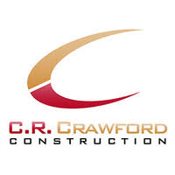
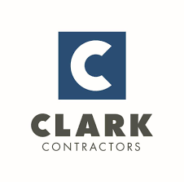
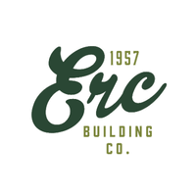
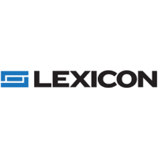
Arkansas

Slide 12
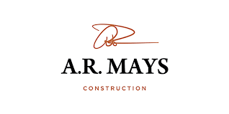
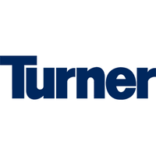
Arizona

Slide 13
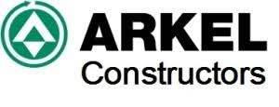
Louisiana

Slide 14
Massachusetts

Slide 15
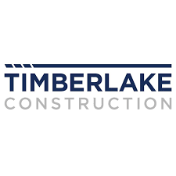
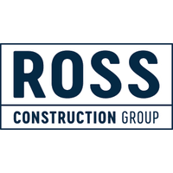
Oklahoma

Slide 16
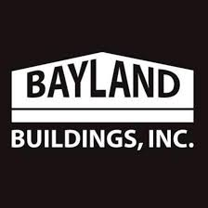
Wisconsin

Slide 17
Washington

