Slide 1
PROCORE FOR U
Daily Log Development
Notes:
To change the background image:
1) Right click on slide
2) Click “Change Background”
3) Select “Choose Image”
4) Go to the Google Drive tab and search “Photography” to find the Procore selects - or - Upload from Computer

Slide 2
Learning Objectives
Define Daily Log in the context of construction
Identify the purposes and components of a Daily Log
Create a Daily Log

Slide 3
What is a Daily Log?
An internal document that records the day-to-day activities and conditions on the site. Typical components include…
Sequential numbering with dates
Project information and name of individual reporting
Weather data
Activities on site that day including deliveries, equipment, and visitors
Subcontractors working on site

Slide 4
Is a Daily Log = Diary?
A diary differs from the daily log in multiple ways:
Often kept by multiple people on the job
Include opinions, attitudes, and judgments of those on the job site
Often handwritten with each entry signed and dated
Subjective and/or opinionated

Slide 5
Why are Daily Logs Needed?
Provides a system to study long-term jobsite patterns and progress to date.
Provides formal record of activities.
Can be used to develop as-built schedule.
May be required in the event of a dispute.

Slide 6
Correct Information is Critical
When possible, use documented sources to document job conditions like weather
Weather delays may influence time extensions per the contract.
Some materials may require certain ambient conditions during installation.

Slide 7
Why might it be important to document deliveries?
As part of your contract, you are installing some items purchased by the owner and delivered to the job. Why might documenting this delivery be important to the GC?

Slide 8
Why might it be important to document subcontractors working on site?
Masonry is on the critical path for your project. Why might it be important for the GC to document the masons working on the job each day?

Slide 9
Why might it be important to document equipment on site?
You are involved in a project that involves a large amount of site work with heavy equipment on site for an extended period of time. How could documenting this help your firm?

Slide 10
Writing a Daily Log
Key Components
Be factual.
Avoid conveying opinion or attitude.
Report normal and abnormal.
Record hours worked by cost code.
Complete it daily.
Notes:
Some constructors believe that only the stuff that goes wrong should be detailed. In contrasts, documenting the normal occurrences of the job are often more critical.
Failure to complete daily logs each calendar day leads to errors and omissions in information.

Slide 11
Writing a Daily Log
Key Components
Be factual.
Avoid conveying opinion or attitude.
Report normal and abnormal.
Record hours worked by cost code.
Complete it daily.

Slide 12
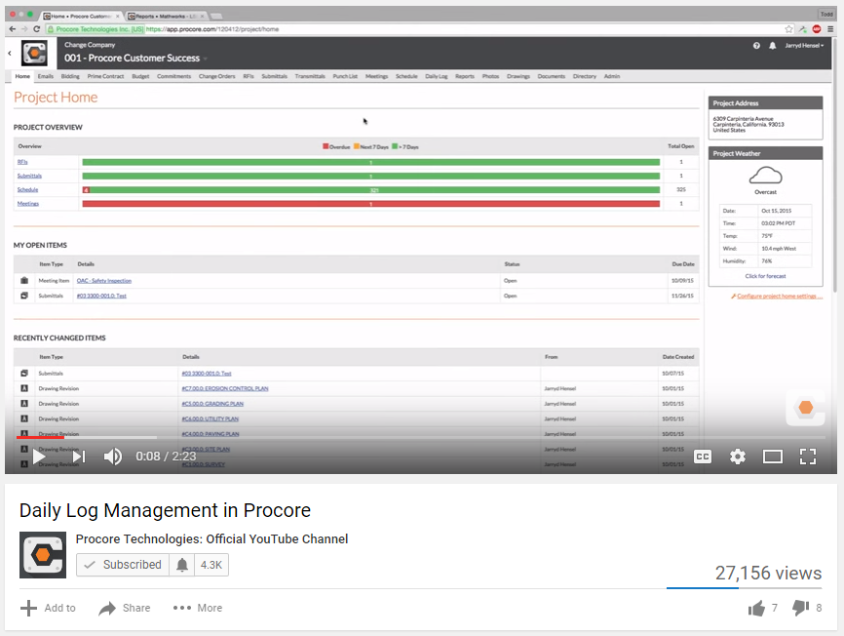
Using Procore for Daily Logs

Slide 13
Daily Log Exercise
Daily Log Exercises #1 and #2
Notes:
If the instructor wishes, this is a good place to insert an exercise related to the daily log. Use Procore’s prepared exercise or another of your choosing.

