Slide 1
Construction Submittals

Slide 2
Learning Objectives
Define Submittals in the context of construction
Identify the purposes and components of a Submittal
Recognize the steps in the Submittal process
Create a Submittal

Slide 3
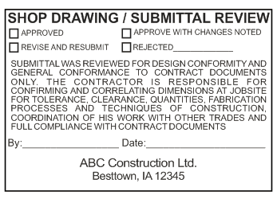
What is a Submittal?
A set of documents that allow the architect and/or engineers to confirm that the products to be installed on the job site match the intent of the design documents.

Slide 4
Submittals, Submittal Packages, Transmittals…
Submittal - Set of documents for a single element of the work
Submittal Package – Group of similar work package items (concrete stain and concrete mix)
Transmittal – Cover letter defining when sent, compliance with specifications, and request for review and approval

Slide 5
What types of Submittals Occur?
Types of Submittals
Shop Drawings: prepared by suppliers, vendors, manufacturers or contractors detailing some element of the work
Samples / Mock-ups: actual elements that illustrate materials, workmanship, and/or equipment
Product Data / Certifications: performance metrics that document anticipated performance

Slide 6
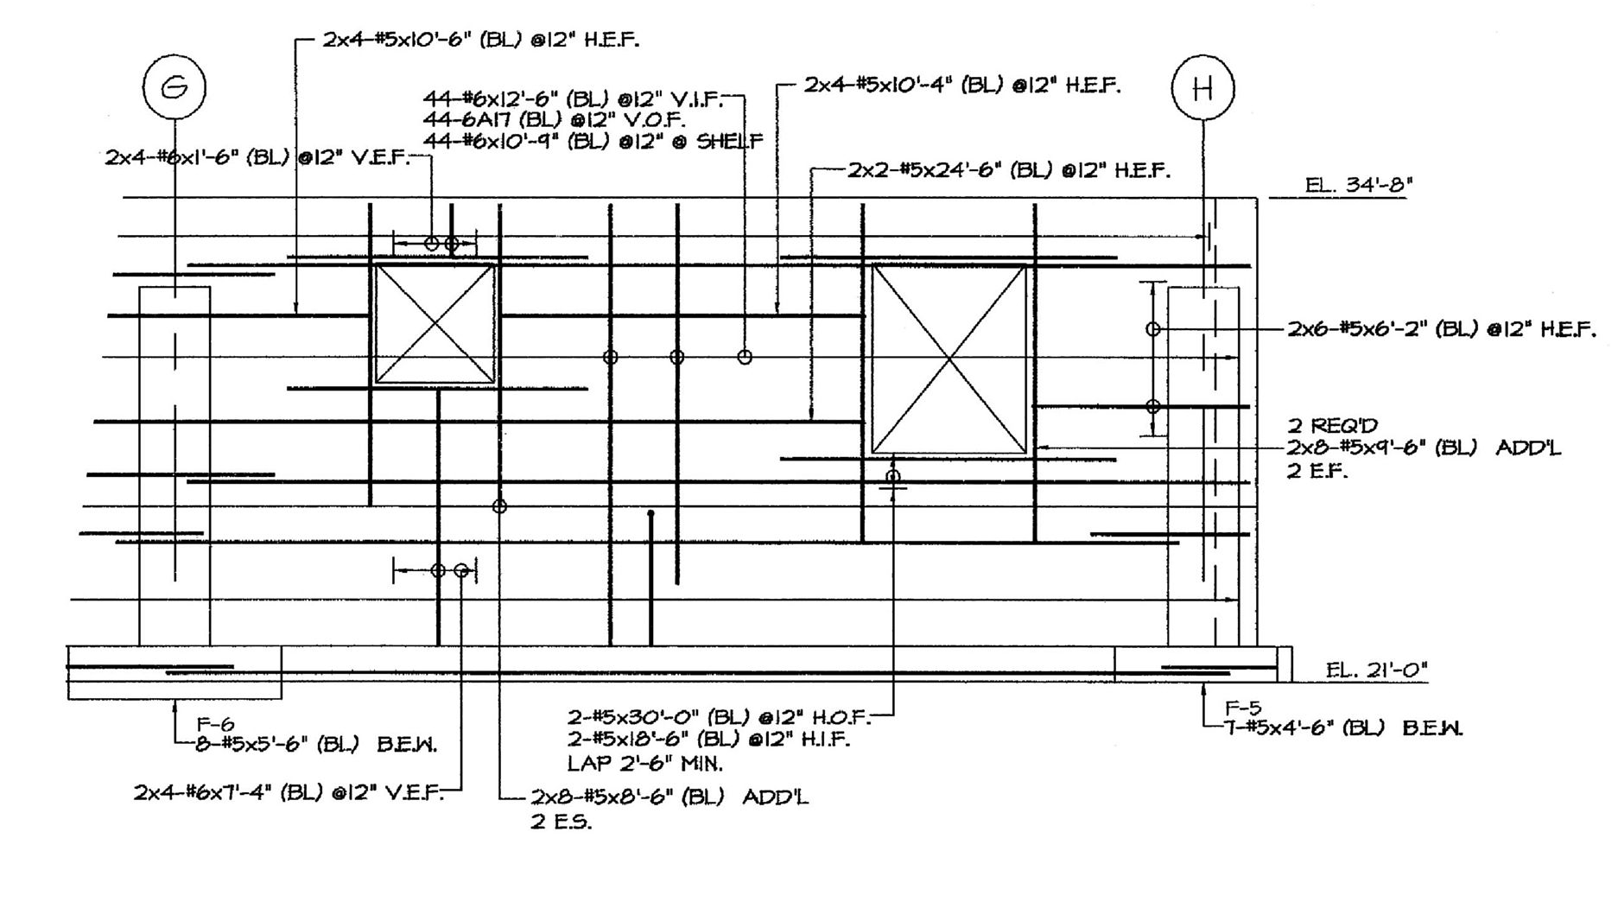
What types of Submittals Occur?
Notes:
This is a small piece of a concrete reinforcement shop drawing. Note what is shown. All rebar in the wall is shown with quantity and lengths. Bars that are not straight have a designation like 6A17 denoting a bar bend schedule likely shown elsewhere on the drawings.

Slide 7
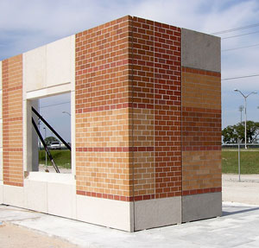
Example of a Sample
A sample panel of brick and precast (Mock-up)
Shows 2 different mix designs
Illustrates effects of sandblasting

Slide 8
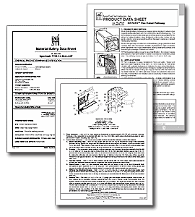
Example of Product Data
Includes manufacturer’s product data
Trade name, model, quantities
Use/performance criteria
Size and physical characteristics
Submittal for Firestopping from stifirestop.com
Notes:
This information is necessary to compare the submitted item with the specified products and acceptable products identified in the specification and/or addenda.

Slide 9
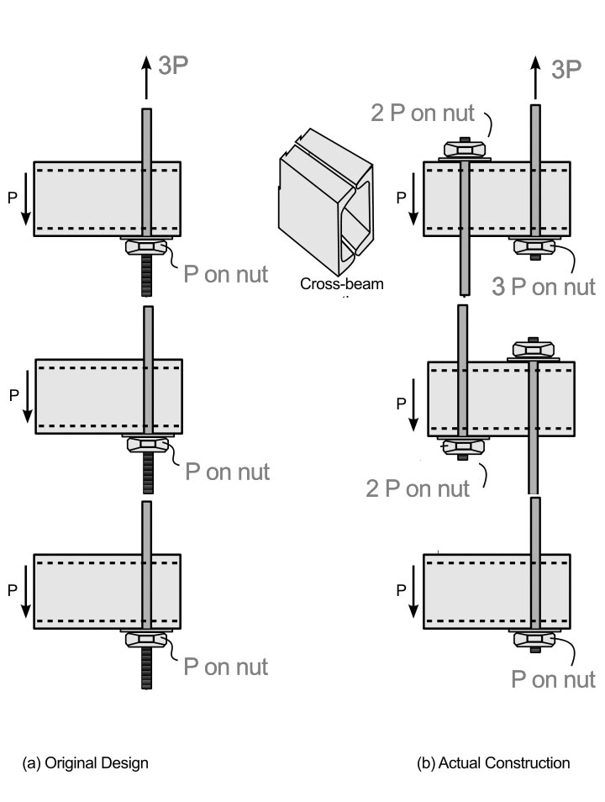
Why are Submittals Critical?
Hyatt Regency Walkway Collapse
July 1983-113 people killed; 186 injured
Original design had 46’ threaded rods
Approved shop drawings used (2) rods
Change led to failure
Notes:
Interestingly, it was found that neither the original design or the revised design was adequate. However, most engineers agree that had the original design been used, the failure would not have occurred. The judge found the engineer guilty of not adequately reviewing the submittal (one way to phrase it). The project highlights the importance of good communication among project participants. Had the change been communicated more effectively, there was a chance the problem would have been identified before people were killed and injured.

Slide 10
The Importance of an Effective Tracking System
Number of submittals on any given project can be daunting
Must have tracking system
Some need quick processing; some have more time
Technical specs say what must be submitted; general conditions outline process

Slide 11
A Preliminary Schedule of Submittals
Before construction, the contractor develops a preliminary schedule of submittals
Allows others to plan review time to meet schedules
Allows coordination of shop drawings with the overall project schedule
Key items that are time-critical are flagged
Notes:
Ask students to make a list as to what they will have to do if they are responsible for overall shop drawing coordination on the job. Put the list on the board. It may look like… 1) Make sure submittals are received from subcontractors and vendors on schedule. 2) Monitor the review time in the GC’s office. 3) Track the review time with the Architect and Engineer. 4) Coordinate any “back and forth” discussion between reviewers during the review process.

Slide 12
Submittal Flow Chart
Sub/Supplier
CM/GC
AE

Slide 13
Authoring a Submittal
Key Components
Ensure the work package is submitted simultaneously (don’t submit doors without frames and hardware)
Make sure to review the submittal before forwarding to the AE or CM/GC.
Be clear on any time requirements on the transmittal (State where submitted “as specified”, “equal to” or “substitute”)
Review architect/engineer comments on return to confirm no scope changes
Notes:
A good discussion could be had on what the contractor is actually reviewing. Quantities? Matching specifications? Fit-up? The answer may depend on the type of work, schedule, contractual relationships, etc…

Slide 14
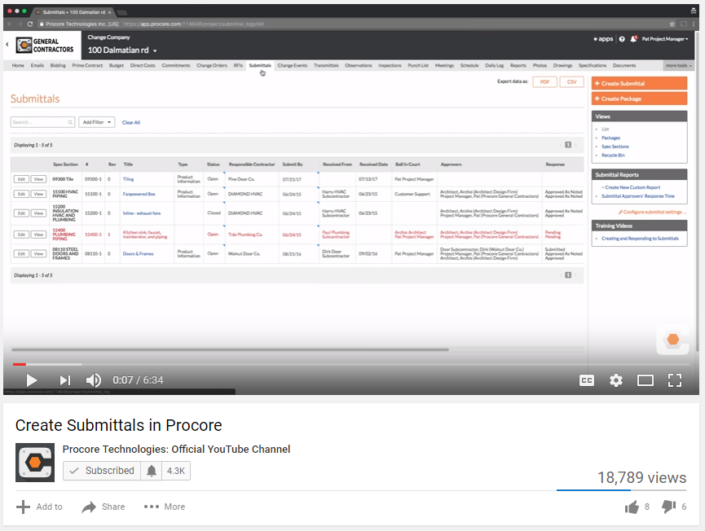
Using Procore for Submittals

Slide 15
Submittal Exercise
Submittal Exercises #1 - #5

