Slide 1
RFI Development
Request for Information

Slide 2
Learning Objectives
Define an RFI
Identify the purposes and components of an RFI
Analyze RFIs written by others
Create an RFI
Notes:
Building professionals rely on employees to write RFI professionally and in a manner that will elicit the best response possible in a timely manner. However, little training is provided in the industry on RFIs. This presentation can be used to help others understand what an RFI is, how and why it is used, what does not work with an RFI, and what best practices may produce the highest quality results for RFIs.

Slide 3
What is an RFI?
A formal document generated by a contractor requesting information not contained within the contract documents
Documents the question and answer
Ensures all affected parties are informed of the question and response
Can be initiated by multiple parties but usually follows a chain of command
Notes:
Contractors sometimes write RFIs for items that are in the contract documents. This has led to an industry perception by some designers that the RFI process is abused. The danger here is that those who answer RFIs will not take the ones that are critical as serious.

Slide 4
Why are RFIs Needed?
Drawings can be interpreted in multiple ways
Greater detail on drawings is needed
Existing conditions can be different than expected
Formal documentation of an on-site conversation
Source: Navigant Construction Forum
Notes:
3 key statistics were quantified in a Navigant Construction Forum. These included RFI response time, total labor cost per RFI, and percentage of RFIs not answered. The cost of reviewing RFIs was more than $1,000 each. 22% of RFIs are never answered. They identify that “no response” is a major reason for disputes on projects. The study also identifies that the lack of a formalized process is one of the reasons RFIs are unanswered. Electronic management of the RFIs using a system like Procore has the ability to substantially improve this.
SOURCE: Impact & Control of RFIs on Construction Projects, Navigant Construction Forum

Slide 5
What an RFI is Not…
An RFI is not used for regular correspondence.
An RFI is not used to direct work but is used to provide information to allow work to be completed correctly.
Source: AIA Best Practices - The RFI’s Role in the Construction Process:
http://www.aia.org/aiaucmp/groups/secure/documents/pdf/aiap016381.pdf
Notes:
The next slide has notes that identify some of the negative perceptions of RFIs from those outside the construction industry.

Slide 6
A Justified RFI?
An RFI is justifiable if a question, concern or observation cannot be explained or answered in the contract documents.
An RFI is unjustifiable if it questions means or methods … or asks a question whose answer is provided in the contract documents.
Source: 12 Hanna, Tadt and Whited, “Request for Information: Benchmarks and Metrics for Major Highway Projects”.
Notes:
The following is language from the AIA in a White Paper entitled “The RFI’s Role in the Construction Process”: “Occasionally, however, the RFI is misused to provide additional time for the contractor, especially on projects containing liquidated damages. RFIs can also be used to set the stage for future change orders. Increasingly, RFIs are used in lieu of phone conversations or shop-drawing submission questions, which could be far more efficient in resolving minor issues.” It is important to point out to the student that there is a perception in the industry among architects and engineers that contractors have abused the RFI process at their expense. All parties must work to insure that the RFI process does what it is supposed to do which is provide critical communication between parties that may have competing agendas.

Slide 7
What’s Wrong with this RFI? (RFI #1)
“The dimensions on A3.1 are a bust. Please confirm the height of the brick is 4’-8”.”
Notes:
Ask students to write down on a sheet of paper what is wrong with this and how it should be written. Then, have them pair with another student to compare answers. Once they do this, have a few groups share their thoughts. In general, an RFI should not be used to cast blame or show responsibility of one party or another. The best response is probably just having the last sentence adding a drawing reference for A3.1 along with any section number that may exist. One may point out that including pieces of drawings or specifications or photos may help the responder provide a quicker solution. The less the RFI requires the respondent to search for information, the more likely it is that the RFI will be resolved efficiently.

Slide 8
What’s Wrong with this RFI? (RFI #2)
“Please confirm the depth of the footing at column line A5 is 2’-8” below finished floor (top of footing elevation). It is imperative that a response be received on this RFI within the next 30 minutes. Otherwise, the schedule will be impacted and additional costs will be incurred!!!!!”
Notes:
Ask students to write down on a sheet of paper what is wrong with this and how it should be written. Then, have them pair with another student to compare answers. Once they do this, have a few groups share their thoughts. The last two sentences here really are not appropriate. First, if an RFI requires an immediate response, some other method of communication is more appropriate. Picking up the phone and calling is probably the best bet (or visiting the site). Second, an RFI has a built-in mechanism to indicate the response time. This, in turn is tied to the contract. From a reviewers standpoint, it really begins to discount more critical items where the schedule really is important for an issue when comments like this are attached to every document.
Once the conversation was had on the phone, the constructor could follow-up with an RFI stating the issue and proposed solution. Then, the person responding to the RFI could confirm the solution. This would document the issue for all parties and avoid the time conflict issue.

Slide 9
What’s Wrong with this RFI? (RFI #3)
“We’ve installed the steel on the second floor of the building in Sequence 1. We’ve got an inspection scheduled for later today. There are a few miscellaneous angles that support the brick cladding on the exterior that have not been completed, but I’m hoping that is ok.”
Notes:
Ask students to write down on a sheet of paper what is wrong with this and how it should be written. Then, have them pair with another student to compare answers. Once they do this, have a few groups share their thoughts. This RFI really asks for nothing. It just reports on a condition. An RFI should only be used to obtain needed information. In other words, it must be active (requests information) and not passive (just gives information). Unless there is some other issue here, no RFI is required.

Slide 10
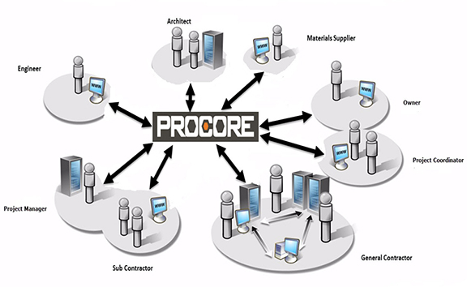
Who is Copied on the RFI?
Any stakeholder associated with the issue
Contractor, Subcontractor, Architect, Engineer, and possibly the Owner
Depends on the contractual relationships and delivery method
Notes:
This is different depending on one’s role in the process and the overall delivery approach for the project. For example, a general contractor may prefer to review all RFIs generated by the subcontractors before forwarding those automatically to the owner or architect.

Slide 11
RFI Components
Sequential numbering
Sender and Receiver (Contact information)
Date developed and Due date
Pertinent question with suggested solution
Reference information
Drawing and specification reference if applicable
Photos, attachments, and/or links
Notes:
Procore only requires the subject, assigned to, and the question fields be completed in their RFIs. It is best to complete as much information as available.

Slide 12
RFI Response
Response is from receiver to sender
Sender then sends the information down (or up) the chain of command
Timely response is required
Duration of turn-around is documented
Allows for delay determination
Notes:
Procore reminds people of outstanding RFIs is through reminder e-mails, project status, and submittal logs.
A documented delay can be useful to contractors in future claims.

Slide 13
RFIs and Change-Orders
An RFI may be a first step in the change order process
If the items in the completed RFI changes money or time, a Change-Order could develop

Slide 14
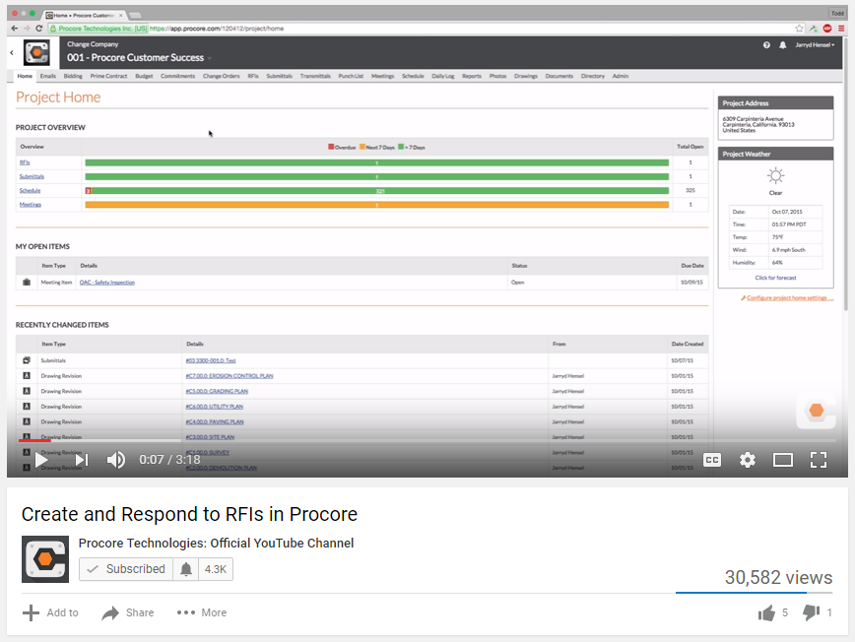
Using Procore for RFIs

Slide 15
An RFI Log in Procore
Notes:
This is an example of an RFI log that Procore creates. This is a powerful tool in making sure all RFIs receive responses.

Slide 16
Writing a RFI
Key Components
Write so that it can be answered simply - “Yes” or “No”, if possible
Consider including the answer you want to receive
Set expectations on RFI responses at or before the initial OAC meeting
Source: Ten Tips on Managing RFIs for Your Construction Projects:
http://www.aconex.com/blogs/2014/01/ten-tips-on-managing-rfis-for-your-construction-projects.html
Notes:
Best Practices for Contractors
Submit an RFI as soon as you know it is required.
Allow 10 days (or as defined by the contract) for a response.
Where multiple RFIs are sent, prioritize what is needed first.
Do not cover more than one subject with a given RFI. Focus on one purpose.
Make specific references to the drawings, sections, and/or details where questions exists. Do not make the reviewer have to “hunt” information.
If you have a suggested response, note it on the RFI.
Indicate if RFI is time sensitive.
Note cost or schedule impacts if they are known when submitting the RFI.
Assume that RFI responses are approval, unless specifically noted otherwise.

Slide 17
RFI Best Practices (1 of 2)
Submit an RFI as soon as you know it is required.
Allow 10 days (or as defined by the contract) for a response.
Where multiple RFIs are sent, prioritize what is needed first.
Do not cover more than one subject with a given RFI. Focus on one purpose.

Slide 18
RFI Best Practices (2 of 2)
Make specific references to the drawings, sections, and/or details where questions exists. Do not make the reviewer “hunt” information.
If you have a suggested response, note it on the RFI.
Indicate if the RFI is time sensitive.
Note cost or schedule impacts if they are known when submitting the RFI.

Slide 19
RFI Exercise
RFI Exercises #1 - #4
Notes:
The instructor may use the Procore provided exercise or may author his/her own.

Slide 20
How to Limit RFIs
Have a clear coordination phase in the design process.
Have someone review the contract documents prior to the job that is outside the team.
Hold detailed scope review meetings with subcontractors and vendors prior to job award.
Have a constructability review of the drawings.
Resolve questions before the final bid.
Make pre-bid meetings effective.
Source: Navigant Construction Forum
Notes:
This element really begins to move beyond the RFI and introduces the idea that there may be some things we can do before the job starts to avoid unnecessary RFIs during the job process. This slide could be omitted if the focus is only on writing RFIs.

Slide 21
Questions?

