Slide 1
Plan Reading Lesson

Slide 2
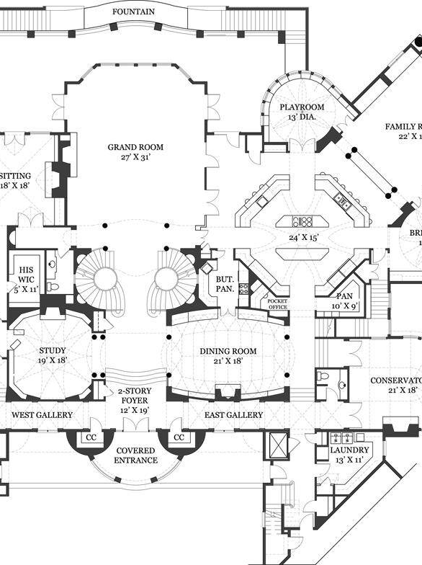
What are plans?
When we use the term plans we are referring to drawings created by an architect or engineer.
Plans are developed by architects and engineers to turn a design idea into a set of particular views that are then used to construct the design.
Let’s learn about a few common types of plans...

Slide 3
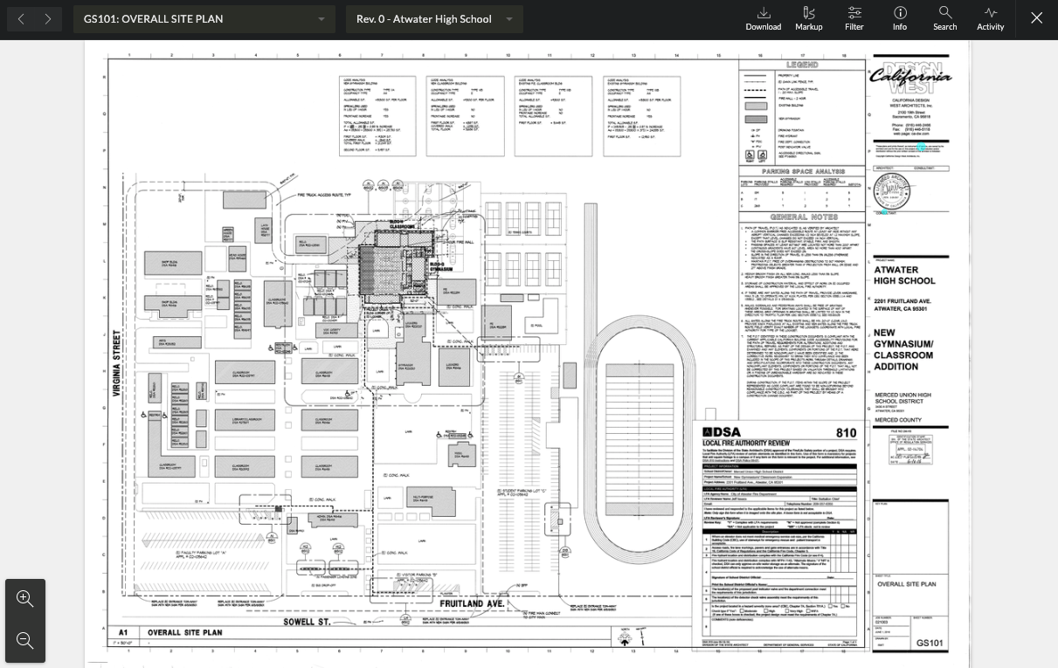
Site Plan
A site plan represents the whole plan of a building.
Includes boundaries, site access, and nearby structures
Shows all service connections like water, electrical, communication cables, and sewer lines

Slide 4
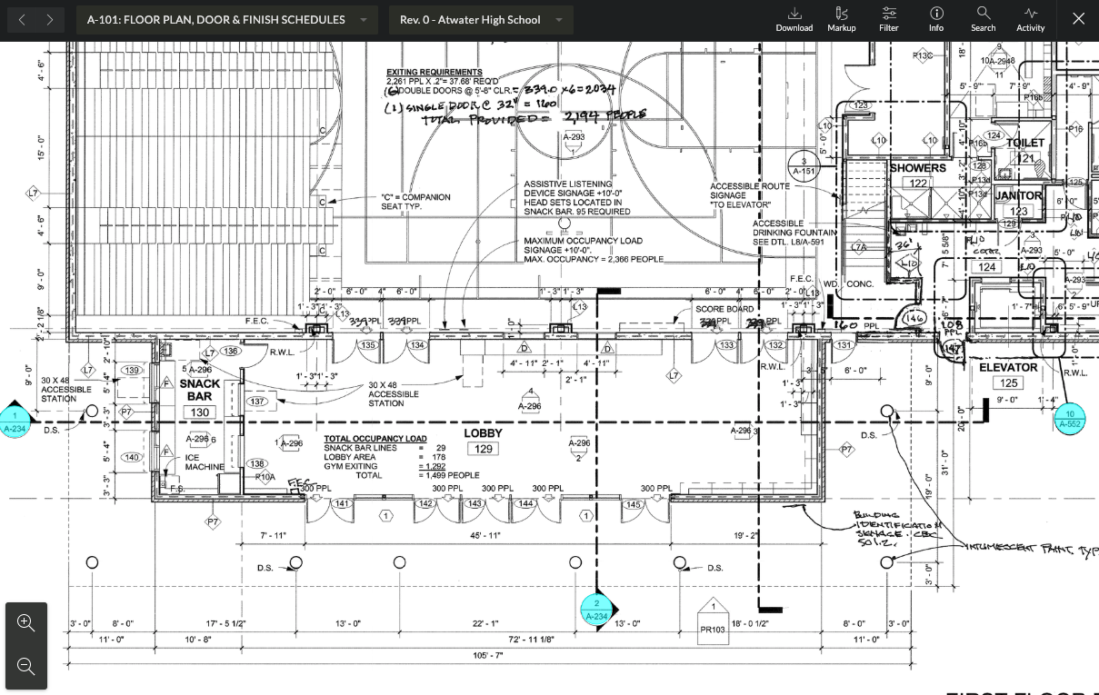
Floor Plan
A floor plan is a view from above that shows how spaces are arranged in a building
Includes the walls, windows, doors, stairs, and sometimes furniture

Slide 5
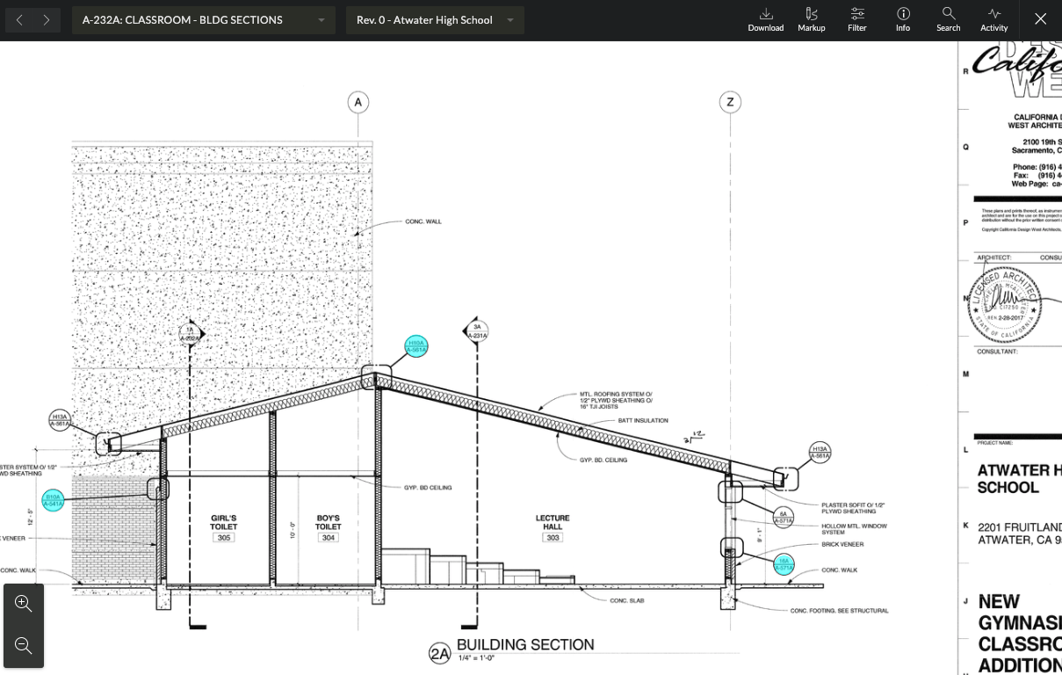
Cross Section Plan
A cross section is a vertical cut section of a building
Shows the details of dimension and height and other details of the structure

Slide 6
Landscape Plan
Designed by a landscape architect
Includes all outside features like plants, walkways, fountains, and other decorative features

Slide 7
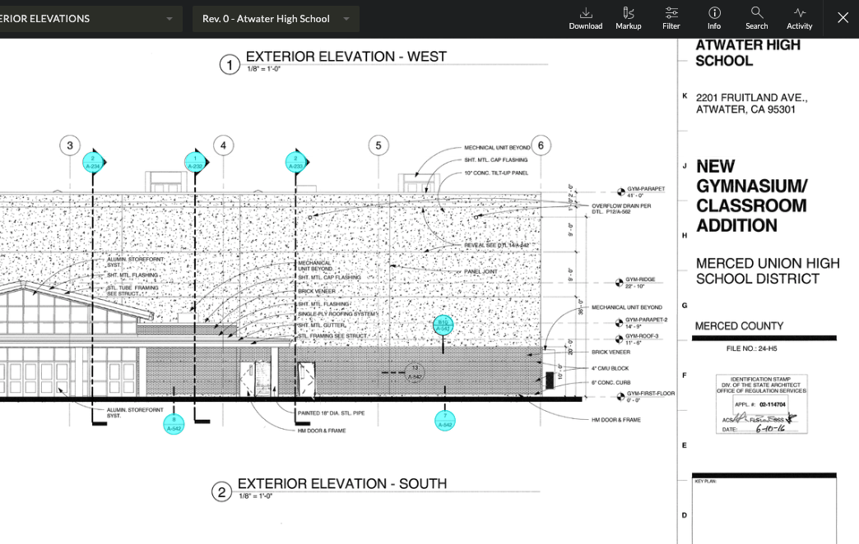
Elevation Plan
An elevation drawing shows the front or side of a building or structure
Interior Elevation
Includes heights of walls, windows, doors and built-ins like fireplaces
Exterior Elevation
Like a photo showing what each side of the building will look like from the outside. Includes overall roof height, windows, and doors.

Slide 8
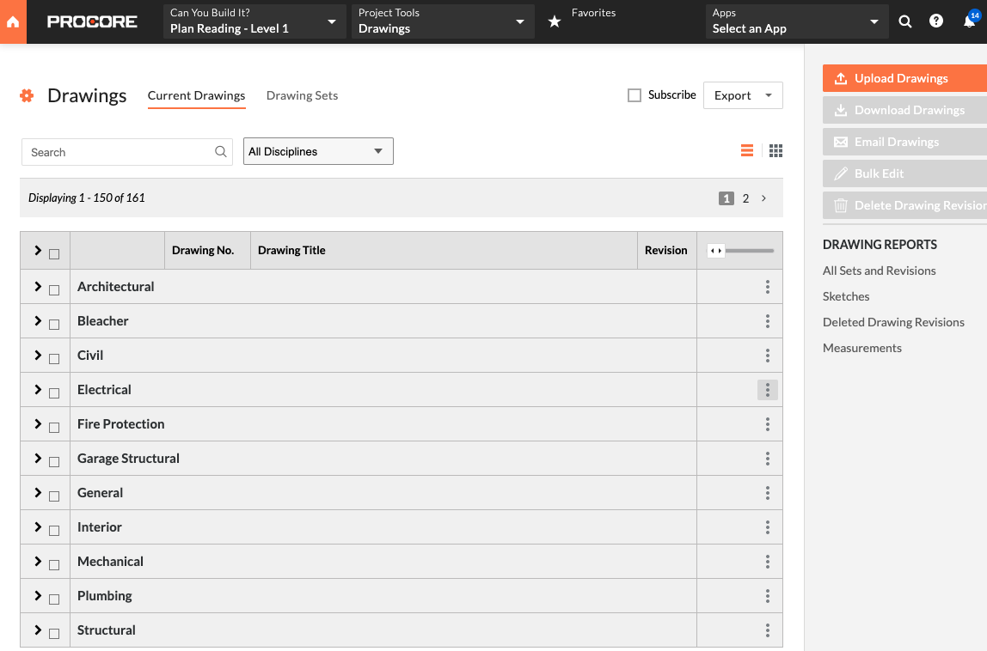
Other types of plans
Structural: Shows the foundation and size and location of structural elements
Civil: Shows information about the construction site
Mechanical: Includes HVAC ducting and equipment involving heating or cooling air
Plumbing: Shows the location of fixtures, equipment, plumbing vents, roof vents
Electrical: Shows receptacles, switches, lighting, control panels, and communication devices

Slide 9
Who needs to read plans?
Architects
Engineers
Builders
Owners
Users of the building
Everyone who needs to be able to understand construction project documents needs to know how to read plans.

Slide 10
POP QUIZ!
1. Where do we find the arrangement of rooms?
2. Where do we find information about plants?
3. Where do we find information about the location of the electrical outlets?
Landscape Plan
Electrical
Floor Plan
Site Plan
Mechanical
Electrical
Landscaping
Architectural
Mechanical
Electrical
Landscaping
Architectural
Notes:
Answer Key:
C
C
B

Slide 11
POP QUIZ!
1. Where do we find the arrangement of rooms?
2. Where do we find information about plants?
3. Where do we find information about the location of the electrical outlets?
Landscape Plan
Electrical
Floor Plan
Site Plan
Mechanical
Electrical
Landscaping
Architectural
Mechanical
Electrical
Landscaping
Architectural
Notes:
Answer Key:
C
C
B

Slide 12
Specs: Don’t build without them
Construction drawings show us the shape, dimensions of a building, while specifications, or specs, provide the details that fill in plans like materials and installation process.
Specs go far beyond the information in the drawings.
Without detailed specs, we wouldn’t know what material to use or how to install it properly.
Notes:
To change the background image:
1) Right click on slide
2) Click “Change Background”
3) Select “Choose Image”
4) Go to the Google Drive tab and search “Illustrated Covers” to find the Procore selects

Slide 13
What’s in a Specification?
Divisions: Divisions represent the typical stages and types of work performed on the jobsite.
Details: Specifications often go into great detail, spelling out the exact processes and products that are to be used for a given element.
Notes:
Slide.

Slide 14
Lifecycle
of Specs
1. Pre-Construction
Specs are presented to the project owners for review and acceptance. Also part of the bid documents that are given to contractors.
2. Construction
Job site personnel need to have ready access to the specs in order to:
Prepare or review submittals
Ensure the right work is being done on site
Record changes to the original design intent that are made in the field
3. After Construction
All of these as-built documents must be collected, organized, and submitted by the contractor to the designer and delivered to the owner.

