Slide 1
BIM Lesson

Slide 2
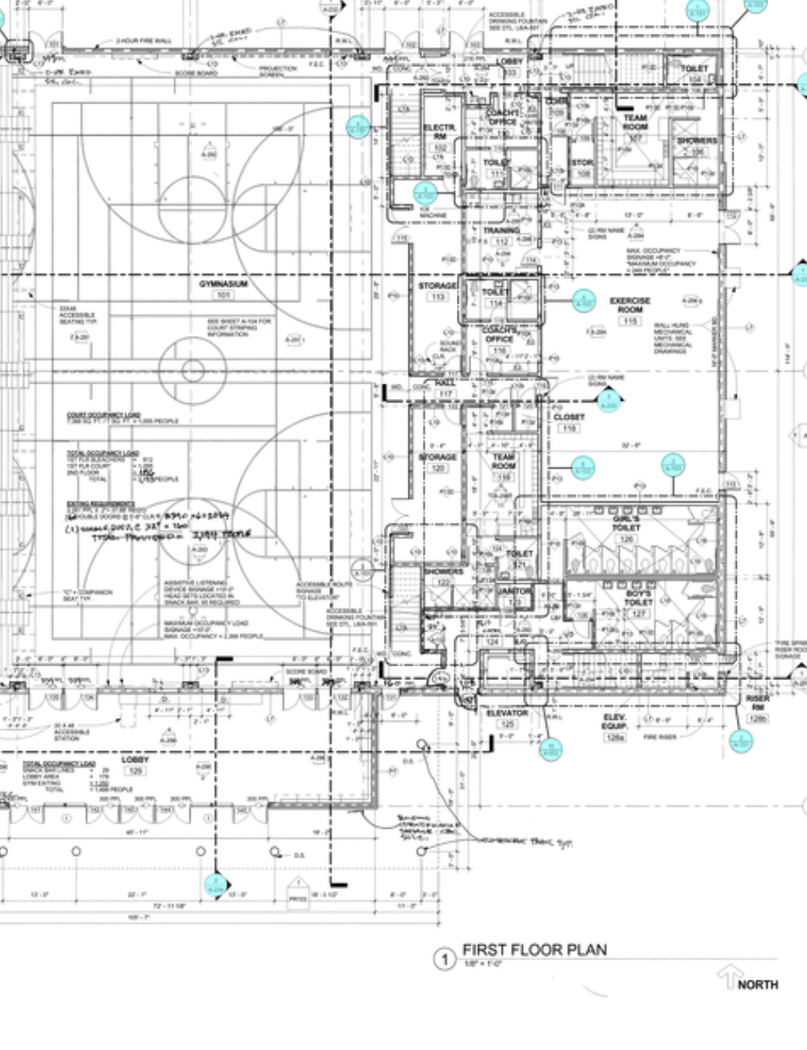
What is BIM?
BIM stands for Building Information Modeling
BIM refers to the technologies and processes that use advanced digital models to improve the design and construction processes

Slide 3
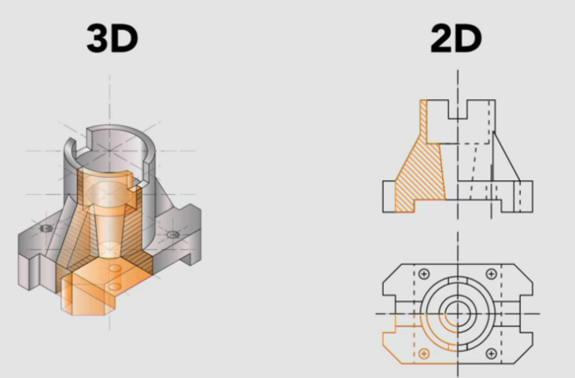
What is BIM?
BIM is more than just digital 2D or 3D model
BIM files are information rich 3D models that pass from the design team to contractors and construction engineers, and then to the owners of the building or infrastructure.
Designing
Building
Managing
Notes:
To change the UI screenshot:
Click on the image
Go to Replace Image in the Menu Bar
Click on Drive and search “Product UI SCreen” in the sidebar to find the folder of Procore selects - or - Upload from Computer
If using Drive, double click on the folder to open, and double click on the your preferred screenshot

Slide 4
Who uses BIM?
BIM connects all AEC professionals...
Architects
Contractors
Engineers
Owners
...so they can
Design cohesively
Build collaboratively
Operate efficiently

Slide 5
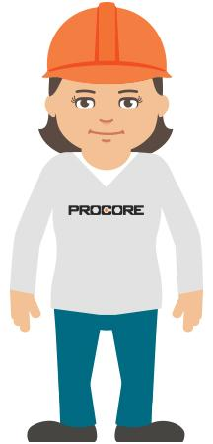
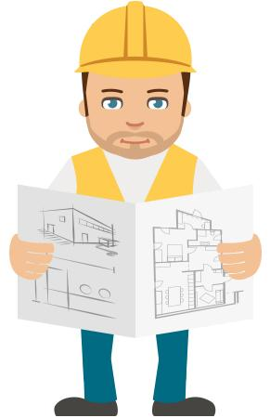
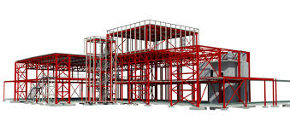
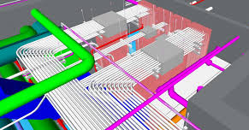
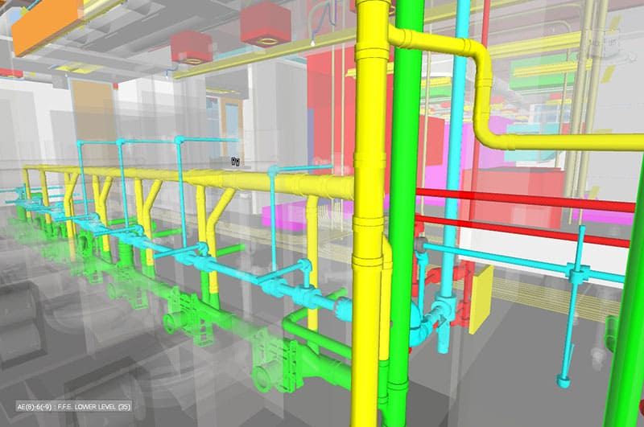
How are BIM models created?
Models are created by individual collaborators
Structural
Electrical
Plumbing

Slide 6
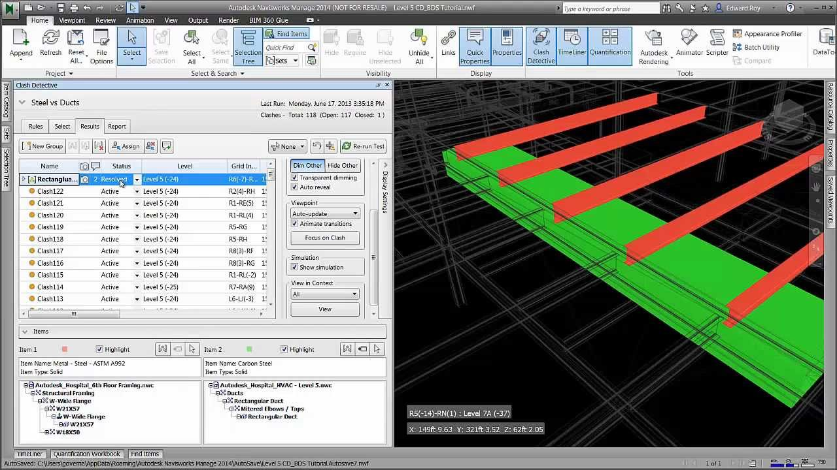
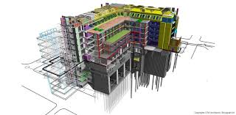
Model federation and clash detection
Each individual model is combined into a single combined model and run within a BIM software that analyzes the model to identify any physical conflicts, or clashes.
Notes:
Federated.

Slide 7
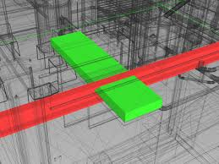
Hundreds, thousands, or even millions of clashes may be detected.
How do we get them all resolved?

Slide 8
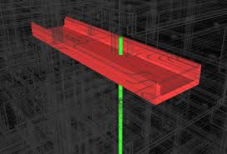
How do we resolve clashes?
After a coordination issue is identified...
Clash is communicated and assigned
Coordination meetings bring together specialty contractors, designers, and engineers to discuss and track coordination issues
Notes:
To change the UI screenshot:
Click on the image
Go to Replace Image in the Menu Bar
Click on Drive and search “Product UI SCreen” in the sidebar to find the folder of Procore selects - or - Upload from Computer
If using Drive, double click on the folder to open, and double click on the your preferred screenshot

Slide 9
What is construction like with BIM?
Coordination
Ensures field teams are installing correctly and working off the latest project files, not operating from siloed information.
Collaboration
Communication is improved between VDC, operations, design, and field teams because all teams have visibility.
Operational Benefits
Clashes are detected early which keeps projects moving, reduces waste, and reduces costs due to rework. It's easy and cheap to fix issue in the model. It's expensive to fix them out in the field.

Slide 10
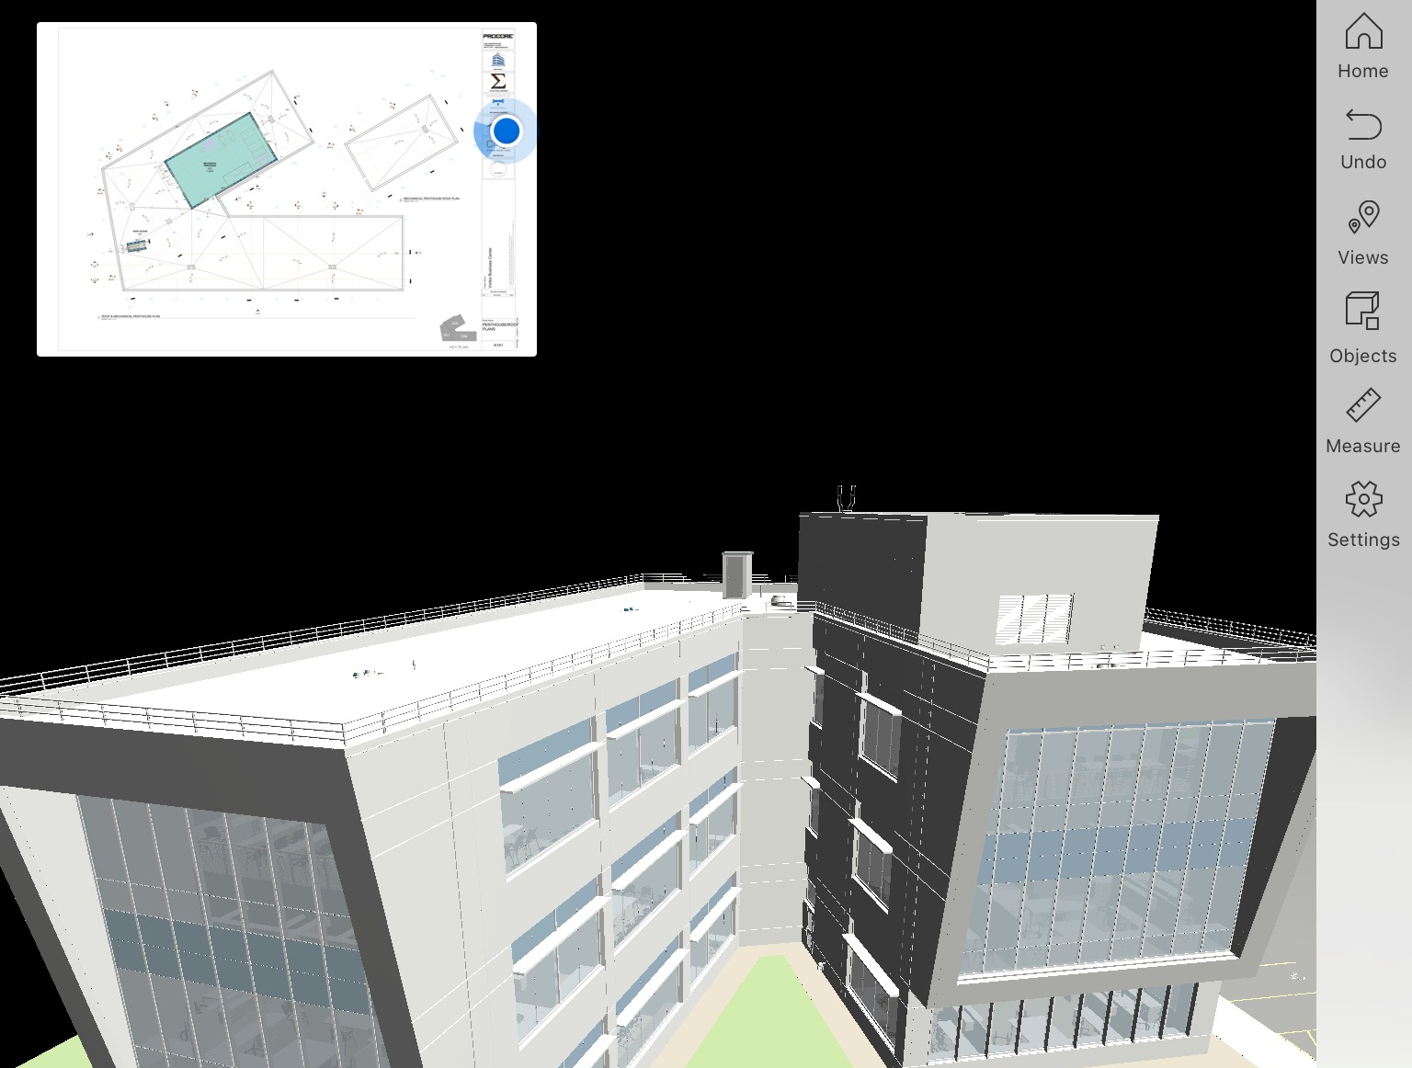
What are the features of Procore BIM?
Fast, easy navigation
Drop into the model from 2D drawings
Use pinch/pull or joysticks
Show object properties
Show model status

